Slide 1

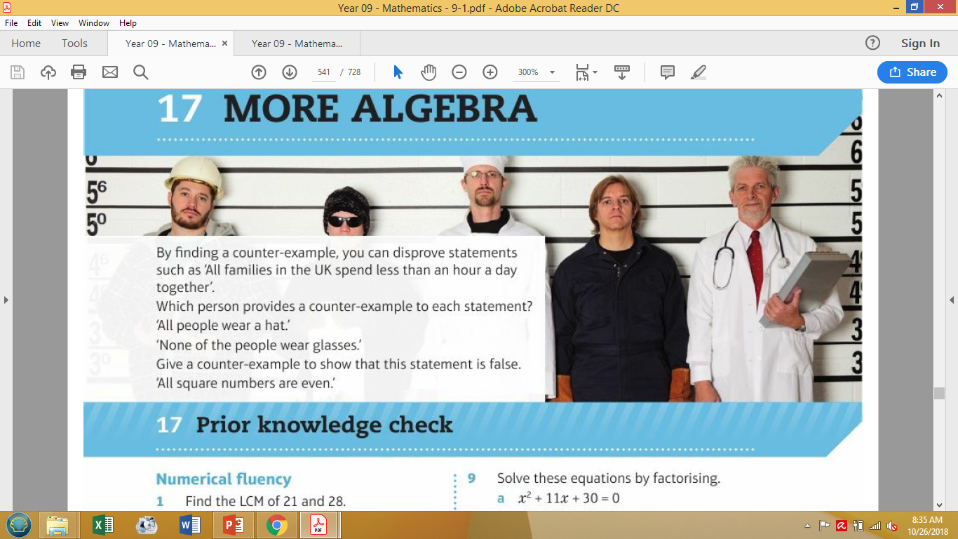
Mathematics (9-1) - iGCSE
2018-20
Year 09
By finding a counter-example, you can disprove statements such as 'All families in the UK spend less than an hour a day together’.
Which person provides a counter-example to each statement? All people wear a hat.'
'None of the people wear glasses.'
Give a counter-example to show that this statement is false. All square numbers are even.'
Unit 17 – More Algebra

Slide 2
Contents
Page iv
17 More algebra 531
Prior knowledge check 531
17.1 Rearranging formulae 532
17.2 Algebraic fractions 533
17.3 Simplifying algebraic fractions 535
17.4 More algebraic fractions 537
17.5 Surds 539
17.6 Solving algebraic fraction equations 541
17.7 Functions 543
17.8 Proof 545
Problem-solving: Surface gravity 548
Check up 549
Strengthen 550
Extend 553
Knowledge check 555
Unit test 556

Slide 3
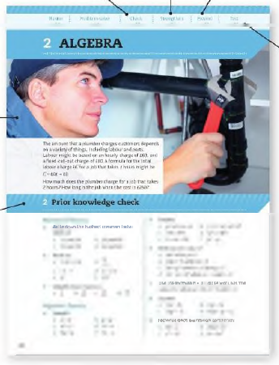
Contents
Page v
At the end of the Master lessons, take a check-up test to help you to decide whether to strengthen or Extend our learning
Extend helps you to apply the maths you know to some different situations
Unit Openers put the maths you are about to learn into a real-life context. Have a go at the question - it uses maths you have already learnt so you should be able to answer it at the start of the unit.
When you have finished the whole unit, a Unit test helps you see how much progress you are making.
Choose only the topics in strengthen thay you need a bit more practice with. You’ll find more hints here to lead you through specific questions. Then move on to Extend
Use the Prior knowledge check to make sure you are ready to start the main lessons in the unit. It checks your knowledge from Key Stage 3 and from earlier in the GCSE course. Your teacher has access to worksheets if you need to recap anything.

Slide 4
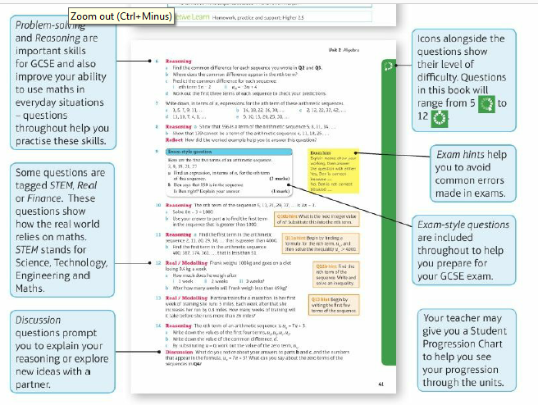
Contents
Page vi

Slide 5
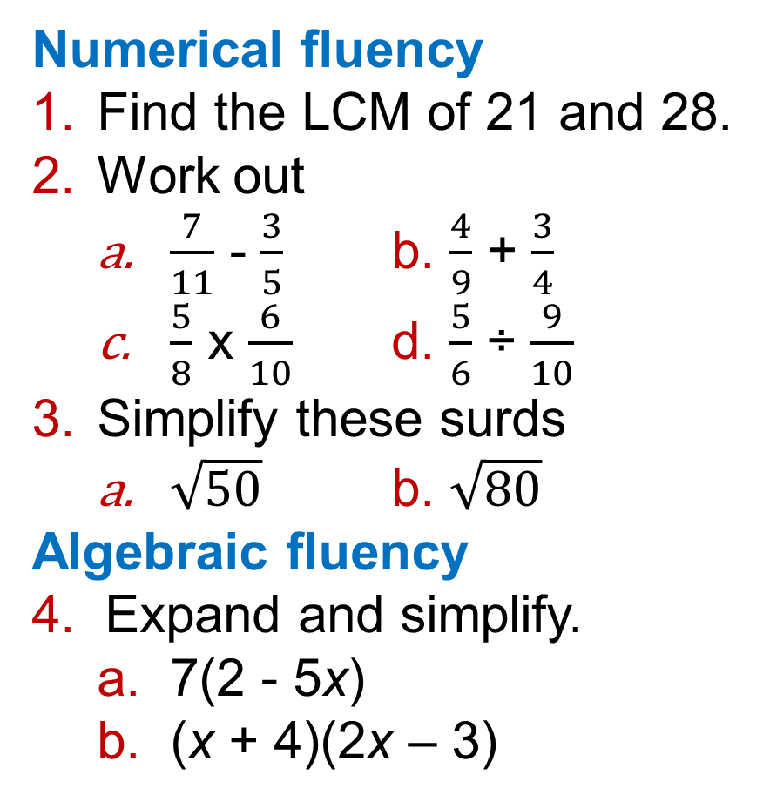
17 – Prior Knowledge Check
Page 531
Numerical fluency
Find the LCM of 21 and 28.
Work out
  $\frac{7}{11}$ - $\frac{3}{5}$ b. $\frac{4}{9}$ + $\frac{3}{4}$
  $\frac{5}{8}$ x $\frac{6}{10}$ d. $\frac{5}{6}$ ÷ $\frac{9}{10}$
Simplify these surds
  $\sqrt{50}$ b. $\sqrt{80}$
Algebraic fluency
Expand and simplify.
  7(2 - 5x)
  (x + 4)(2x – 3)

Slide 6
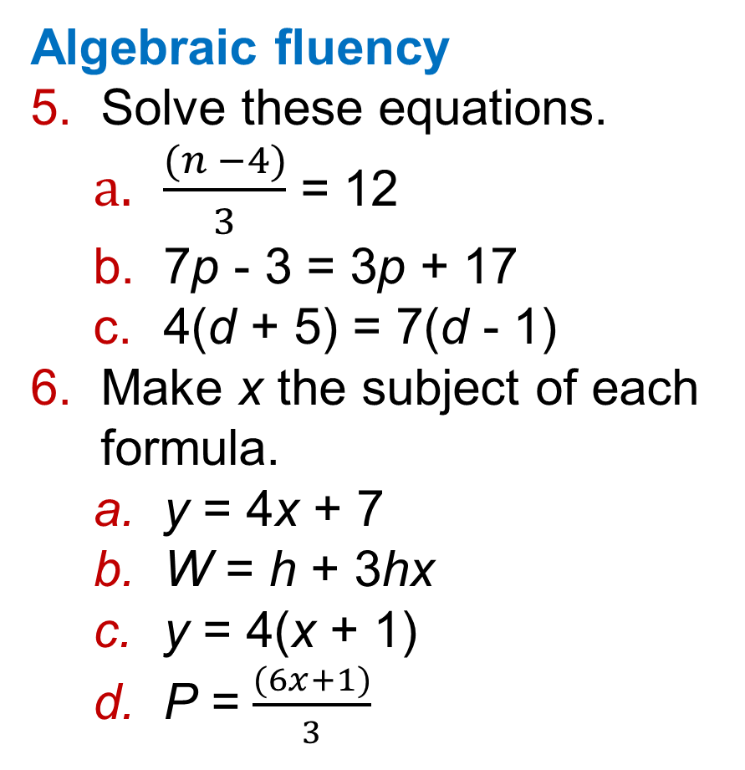
17 – Prior Knowledge Check
Page 531
Algebraic fluency
Solve these equations.
  $\frac{(n −4)}{3}$ = 12
  7p - 3 = 3p + 17
  4(d + 5) = 7(d - 1)
Make x the subject of each formula.
  y = 4x + 7
  W = h + 3hx
  y = 4(x + 1)
  P = $\frac{(6x+1)}{3}$

Slide 7
17 – Prior Knowledge Check
Page 531
Algebraic fluency
Simplify
  y³ x y⁵ b. 4y² x 7y⁴
  y⁸ ÷ y
  10y⁷ ÷ 25y²
Factorise
  x² + 6x +5
  x² – 7x - 30
  x² – 5x + 6
  x² - 36

Slide 8
17 – Prior Knowledge Check
Page 531
Solve these equations by factorising,
  x² + 11x + 30 = 0
  x² -12x + 11=0
  2x² + 9x + 7 = 0
Solve x² + 5x + 2 = 0 by using the quadratic formula. Leave your answer in surd form.
Solve x² + 8x +10 = 0 by completing the square. Leave your answer in surd form.

Slide 9
17 – Prior Knowledge Check
Page 531
* Challenge
a. Write down any five consecutive integers.
  Work out their sum.
  Repeat parts a and b for four more sets of consecutive integers.
  What do you notice?
  Predict the missing number in this sentence.
  The sum of five consecutive numbers is. multiple of ____.
  Use algebra to show why this happens.
Q12e hint – Let the numbers be n, n+1, n + 2…

Slide 10
17.1 – Rearranging Formulae
Page 532
Objectives |  | Why Learn This?
Change the subject of a formula where the power of the subject appears. Change the subject of a formula where the subject appears twice. |  | Physicists rearrange complex formulae in order to find important measures.
Fluency
y = 5x - 2. Find the value of x when y = 3 • y = -7 • y = 0
ActiveLearn - Homework, practice and support: Higher 17.1

Slide 11
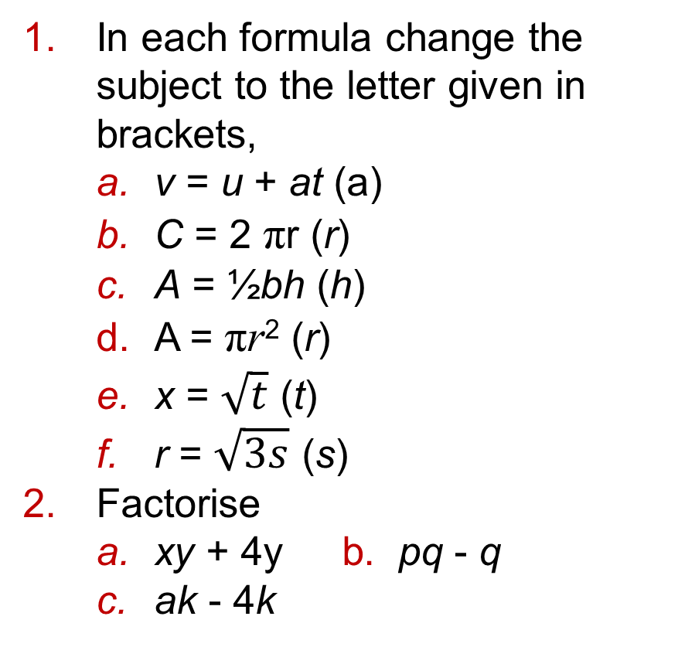
17.1 – Rearranging Formulae
Page 532
In each formula change the subject to the letter given in brackets,
  v = u + at (a)
  C = 2 πr (r)
  A = ½bh (h)
  A = πr² (r)
  x = $\sqrt{t}$ (t)
  r = $\sqrt{3s}$ (s)
Factorise
  xy + 4y b. pq - q
  ak - 4k
Warm Up
Questions in this unit are targeted at the steps indicated.

Slide 12

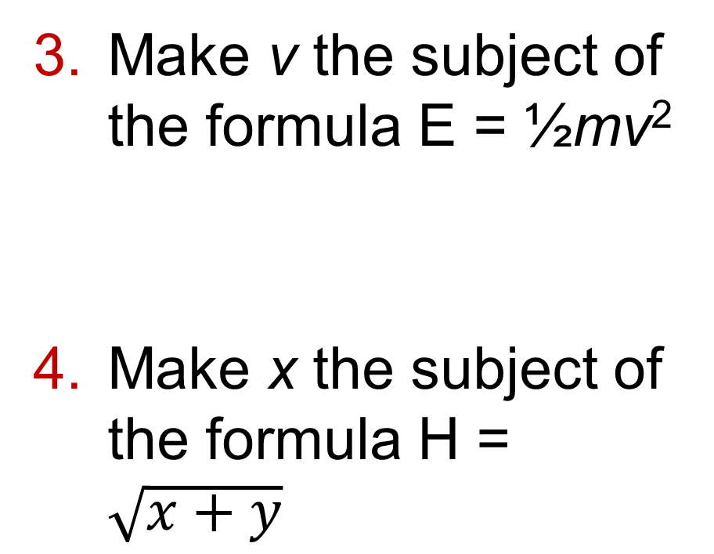
17.1 – Rearranging Formulae
Page 532
Make v the subject of the formula E = ½mv²
Make x the subject of the formula H = $\sqrt{x+y}$
Q3 hint - First multiply both sides by 2.
Q4 hint - First square both sides.

Slide 13

17.1 – Rearranging Formulae
Page 532
Example 1
Make x the subject of the formula P = d$\sqrt{\frac{x}{y}}$
$\frac{P}{d}$ = $\sqrt{\frac{x}{y}}$
$\frac{P2}{d2}$ = $\frac{x}{y}$
$\frac{yP2}{d2}$ = x or x = $\frac{yp2}{d2}$
Divide both sides by d.
Square both sides.

Slide 14


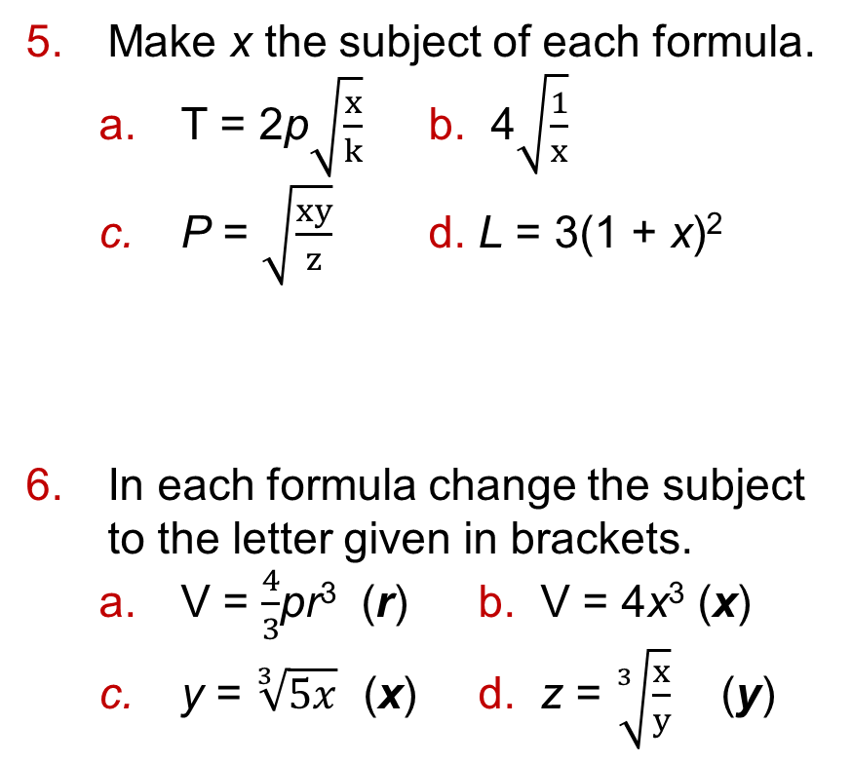
17.1 – Rearranging Formulae
Page 532
Make x the subject of each formula.
  T = 2p$\sqrt{\frac{x}{k}}$ b. 4$\sqrt{\frac{1}{x}}$
  P = $\sqrt{\frac{xy}{z}}$ d. L = 3(1 + x)²
In each formula change the subject to the letter given in brackets.
  V = $\frac{4}{3}$pr³ (r) b. V = 4x³ (x)
  y = $\sqrt[3]{5x}$ (x) d. z = $\sqrt[3]{\frac{x}{y}}$ (y)
Q5d hint - First divide both sides by 3. Then square root both sides
Q4 hint - First make r³ the subject. Finally take the cube root to give r as the subject.
Q5c hint - First cube both sides.

Slide 15

17.1 – Rearranging Formulae
Page 533
Key Point 1
When the letter to be made the subject appears twice in the formula you will need to factorise.
Example 2
Make w the subject of the formula A = wh + lh + lw
A – lh = wh+ Iw
A-lh = w(h + l)
w = $\frac{\text{A} \text{−} \text{lh}}{\text{h}\text{ + }\text{l}}$
w appears twice in this formula.
Subtract Ih from both sides to get the terms in w together on one side of the equals sign.
Factorise the right-hand side, so w appears only once.
Divide both sides by (h + l)

Slide 16
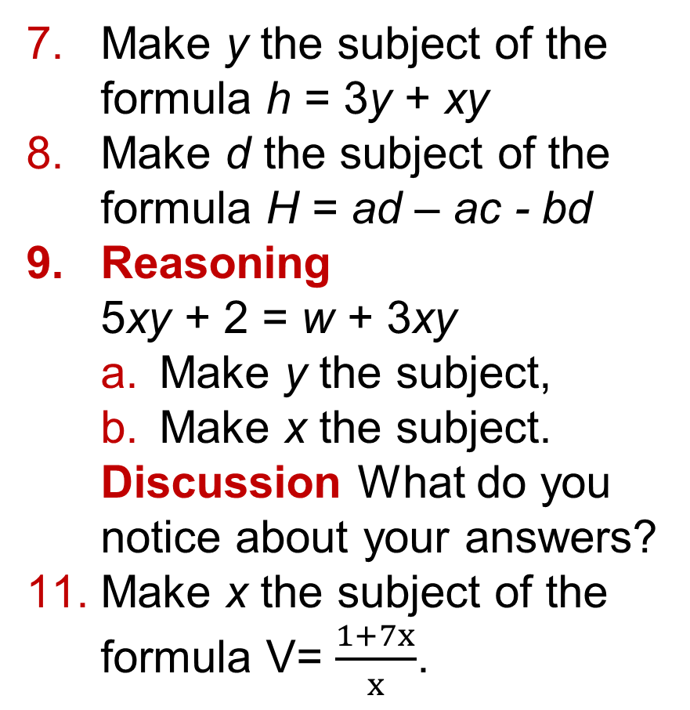
17.1 – Rearranging Formulae
Page 533
Make y the subject of the formula h = 3y + xy
Make d the subject of the formula H = ad – ac - bd
Reasoning
5xy + 2 = w + 3xy
  Make y the subject,
  Make x the subject.
  Discussion What do you notice about your answers?
  Make x the subject of the formula V= $\frac{1+7x}{x}$.
Q11 hint - First multiply both sides by x.

Slide 17
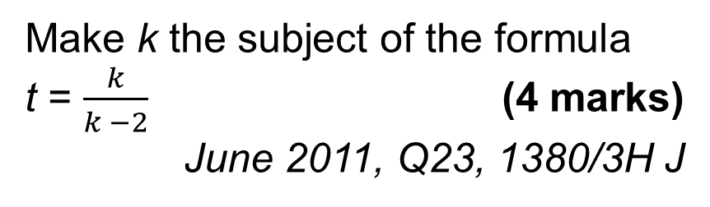
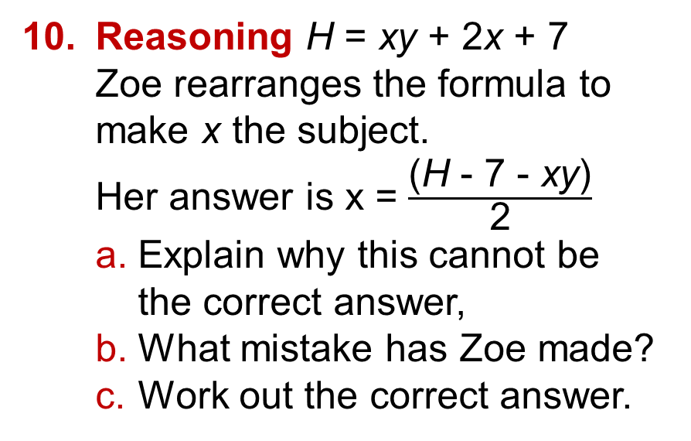
17.1 – Rearranging Formulae
Page 533
Reasoning H = xy + 2x + 7
Zoe rearranges the formula to make x the subject.
Her answer is x = $\frac{\text{(}\text{H} \text{− 7 − }\text{xy}\text{)}}{\text{2}}$
  Explain why this cannot be the correct answer,
  What mistake has Zoe made?
  Work out the correct answer.
12 – Exam-Style Questions
Exam hint
First multiply both sides by (k - 2). Then expand the bracket on the left-hand side.
Make k the subject of the formula
t = $\frac{k}{k −2}$ (4 marks)
June 2011, Q23, 1380/3H J

Slide 18
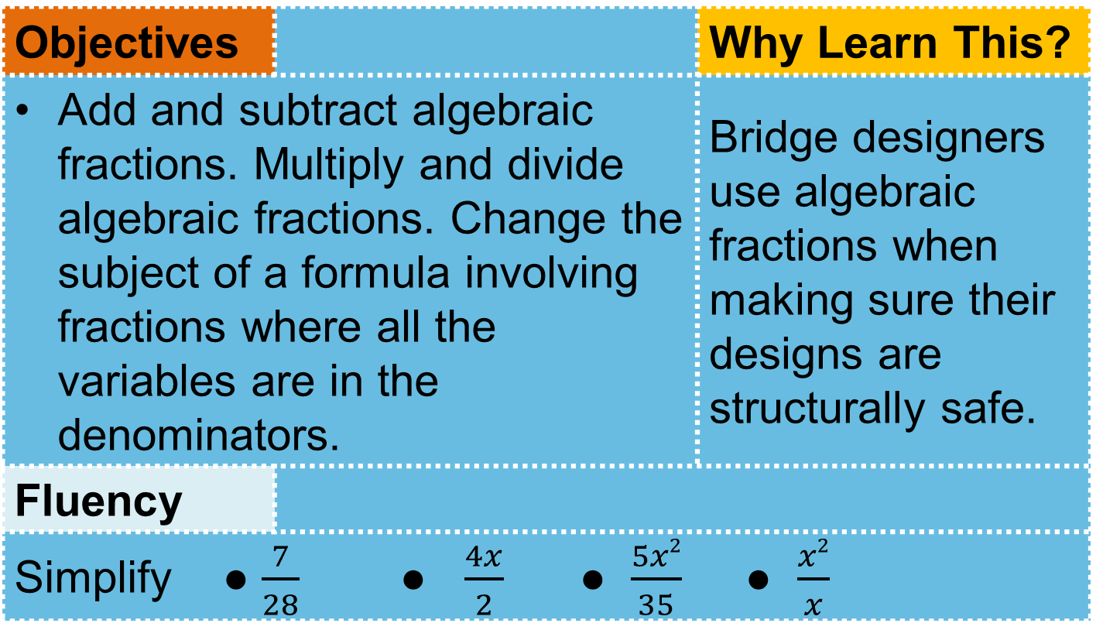
17.2 – Algebraic Fractions
Page 533
Objectives |  | Why Learn This?
Add and subtract algebraic fractions. Multiply and divide algebraic fractions. Change the subject of a formula involving fractions where all the variables are in the denominators. |  | Bridge designers use algebraic fractions when making sure their designs are structurally safe.
Fluency
Simplify ● $\frac{7}{28}$ ● $\frac{4x}{2}$ ● $\frac{5x2}{35}$ ● $\frac{x2}{x}$
ActiveLearn - Homework, practice and support: Higher 17.2

Slide 19
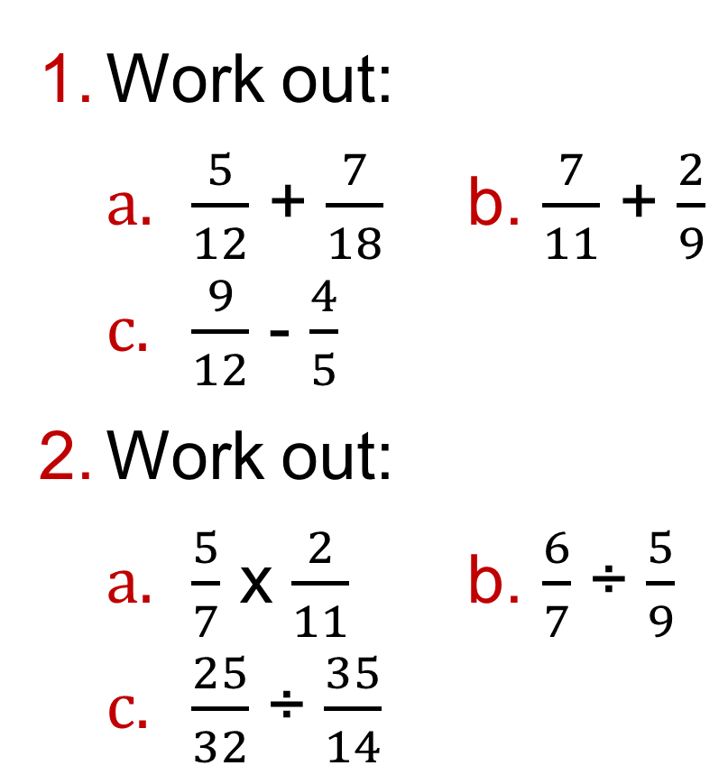
17.2 – Algebraic Fractions
Page 534
Work out:
  $\frac{5}{12}$ + $\frac{7}{18}$ b. $\frac{7}{11}$ + $\frac{2}{9}$
  $\frac{9}{12}$ - $\frac{4}{5}$
Work out:
  $\frac{5}{7}$ x $\frac{2}{11}$ b. $\frac{6}{7}$ ÷ $\frac{5}{9}$
  $\frac{25}{32}$ ÷ $\frac{35}{14}$
Warm Up

Slide 20

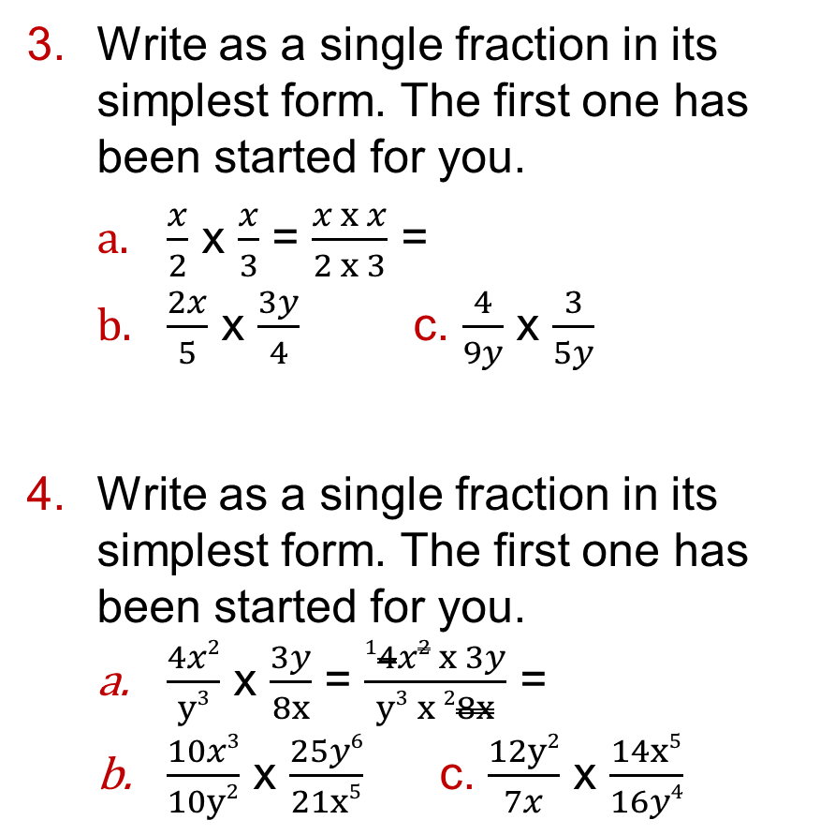
17.2 – Algebraic Fractions
Page 534
Write as a single fraction in its simplest form. The first one has been started for you.
  $\frac{x}{2}$ x $\frac{x}{3}$ = $\frac{x x x}{2 x 3}$ =
  $\frac{2x}{5}$ x $\frac{3y}{4}$ c. $\frac{4}{9y}$ x $\frac{3}{5y}$
Write as a single fraction in its simplest form. The first one has been started for you.
  $\frac{4x2}{y3}$ x $\frac{3y}{8x}$ = $\frac{14x2 x 3y}{y3 x 28x}$ =
  $\frac{10x3}{10y2}$ x $\frac{25y6}{21x5}$ c. $\frac{12y2}{7x}$ x $\frac{14x5}{16y4}$
Q3b hint - First cancel any common factors

Slide 21
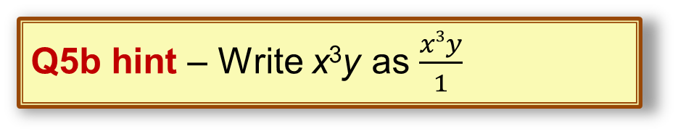
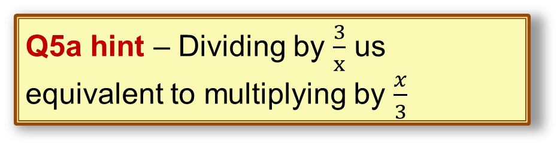
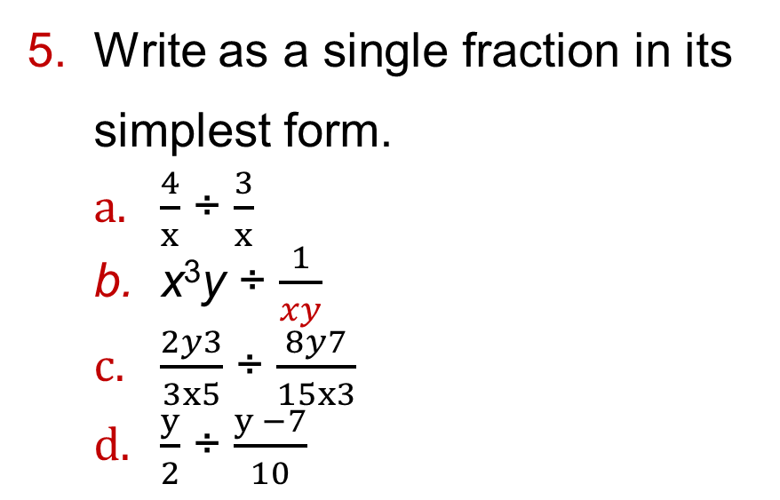
17.2 – Algebraic Fractions
Page 534
Write as a single fraction in its simplest form.
  $\frac{4}{x}$ ÷ $\frac{3}{x}$
  x³y ÷ $\frac{1}{xy}$
  $\frac{2y3}{3x5}$ ÷ $\frac{8y7}{15x3}$
  $\frac{y}{2}$ ÷ $\frac{y −7}{10}$
Q5a hint – Dividing by $\frac{3}{x}$ us equivalent to multiplying by $\frac{x}{3}$
Q5b hint – Write x³y as $\frac{x3y}{1}$

Slide 22

17.2 – Algebraic Fractions
Page 532
Example 3
Simplify $\frac{x}{5}$ x $\frac{x}{3}$
LCM of 5 and 3 is 15
x3 x3
$\frac{x}{5}$ = $\frac{3x}{15}$ $\frac{x}{3}$ = $\frac{5x}{15}$
x3 x3
$\frac{3x}{15}$ + $\frac{5x}{15}$ = $\frac{8x}{15}$
Find the LCM denominators.
Write both fractions with the same denominator.
Add the fractions

Slide 23
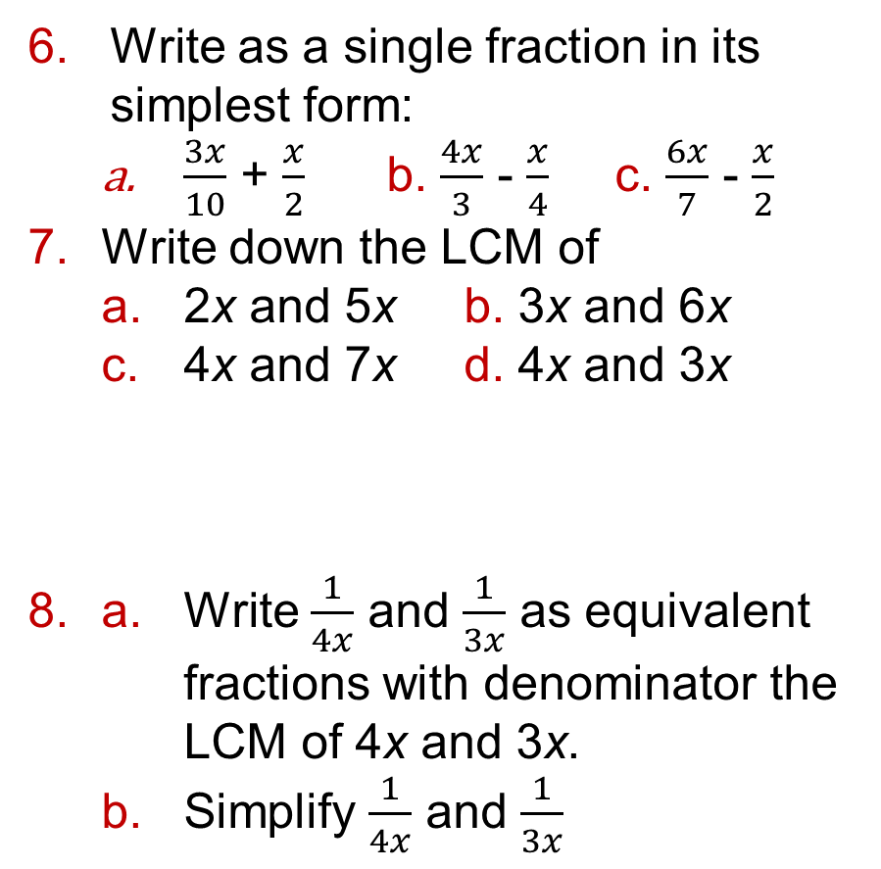
17.2 – Algebraic Fractions
Page 534
Write as a single fraction in its simplest form:
  $\frac{3x}{10}$ + $\frac{x}{2}$ b. $\frac{4x}{3}$ - $\frac{x}{4}$ c. $\frac{6x}{7}$ - $\frac{x}{2}$
Write down the LCM of
  2x and 5x b. 3x and 6x
  4x and 7x d. 4x and 3x
a. Write $\frac{1}{4x}$ and $\frac{1}{3x}$ as equivalent fractions with denominator the LCM of 4x and 3x.
  Simplify $\frac{1}{4x}$ and $\frac{1}{3x}$
Q7a hint –Multiples of 2x: 2x, 4x, ... Multiples of 5x: 5x, 10x, ..

Slide 24
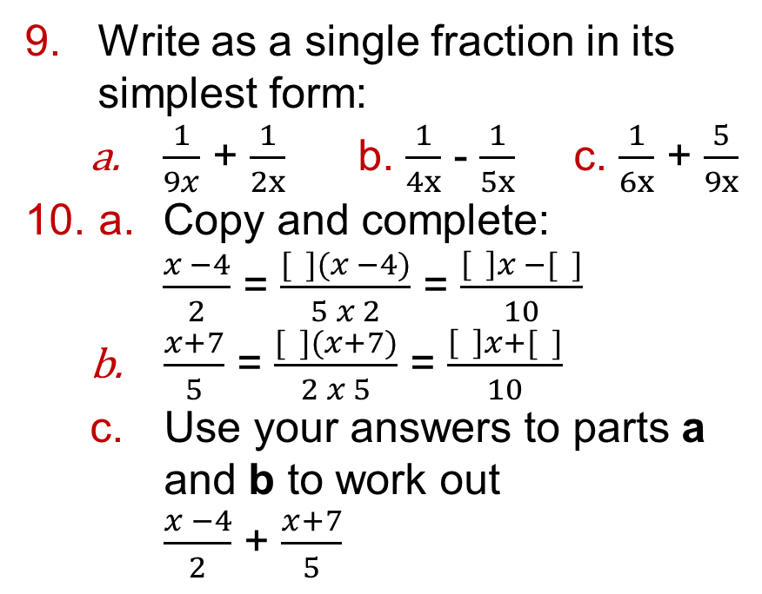
17.2 – Algebraic Fractions
Page 534
Write as a single fraction in its simplest form:
  $\frac{1}{9x}$ + $\frac{1}{2x}$ b. $\frac{1}{4x}$ - $\frac{1}{5x}$ c. $\frac{1}{6x}$ + $\frac{5}{9x}$
a. Copy and complete:
$\frac{x −4}{2}$ = $\frac{[ ](x −4)}{5 x 2}$ = $\frac{\left[ \right]x −[ ]}{10}$
  $\frac{x+7}{5}$ = $\frac{[ ](x+7)}{2 x 5}$ = $\frac{\left[ \right]x+[ ]}{10}$
  Use your answers to parts a and b to work out
  $\frac{x −4}{2}$ + $\frac{x+7}{5}$

Slide 25
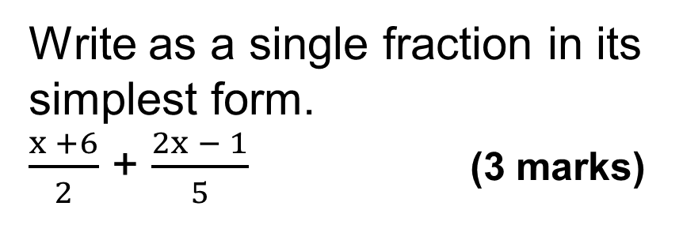
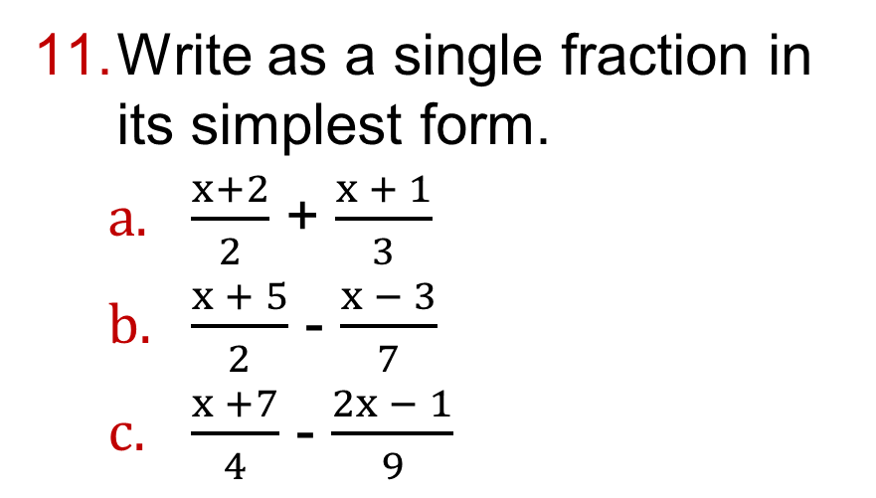
17.2 – Algebraic Fractions
Page 535
Write as a single fraction in its simplest form.
  $\frac{x+2}{2}$ + $\frac{x + 1}{3}$
  $\frac{x + 5}{2}$ - $\frac{x − 3}{7}$
  $\frac{x +7}{4}$ - $\frac{2x − 1}{9}$
12 – Exam-Style Questions
Write as a single fraction in its simplest form.
$\frac{x +6}{2}$ + $\frac{2x − 1}{5}$ (3 marks)
Q12 strategy hint - Start by rewriting each fraction so that the denominator of each is the same.

Slide 26
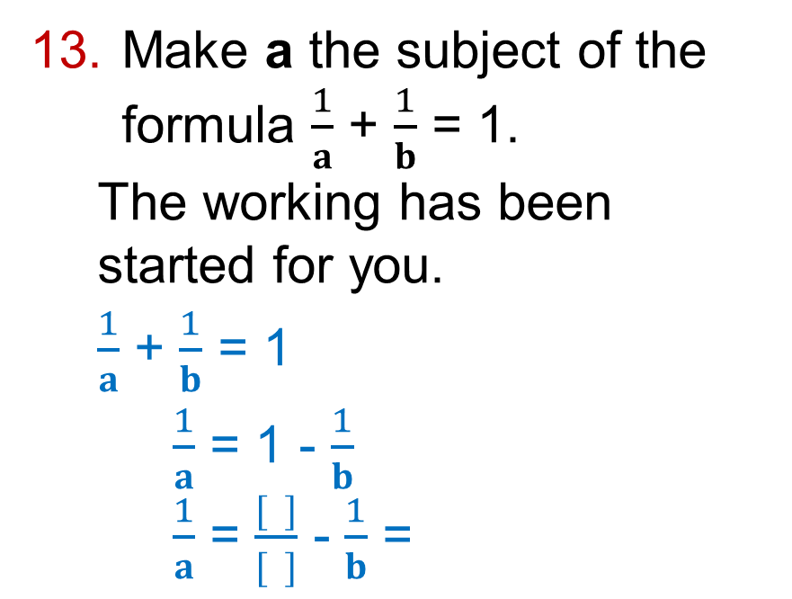
17.2 – Algebraic Fractions
Page 535
Make a the subject of the formula $\frac{1}{a}$ + $\frac{1}{b}$ = 1.
  The working has been started for you.
  $\frac{1}{a}$ + $\frac{1}{b}$ = 1
  $\frac{1}{a}$ = 1 - $\frac{1}{b}$
  $\frac{1}{a}$ = $\frac{[ ]}{[ ]}$ - $\frac{1}{b}$ =
Q13 hint – Write the right-hand side as a single fraction using the common denominator of 1 and b: b. Then find the reciprocal to find a.

Slide 27
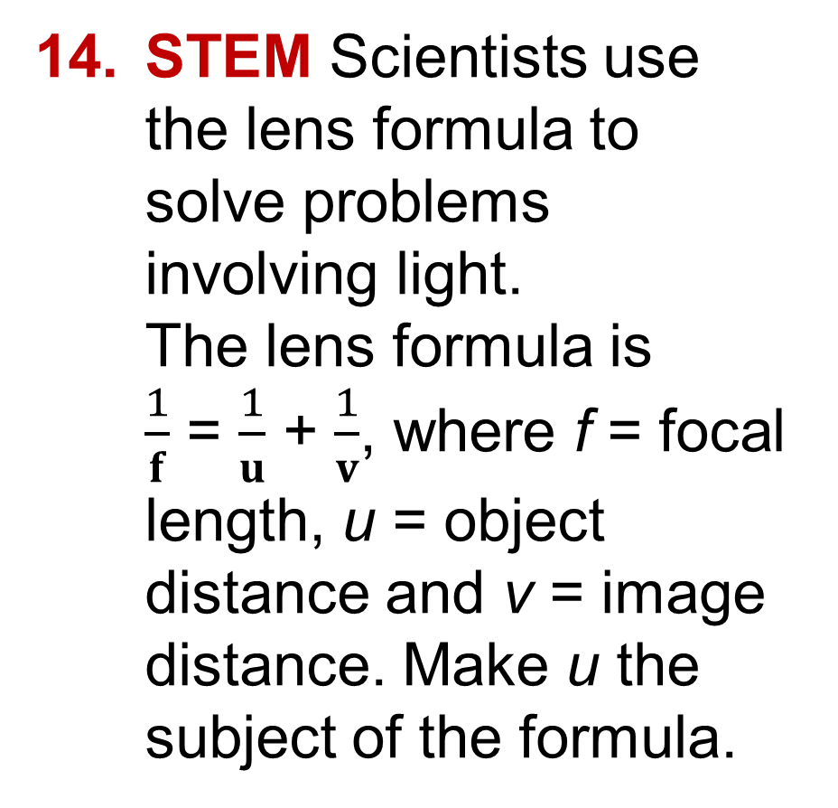
17.2 – Algebraic Fractions
Page 535
STEM Scientists use the lens formula to solve problems involving light.
The lens formula is
$\frac{1}{f}$ = $\frac{1}{u}$ + $\frac{1}{v}$, where f = focal length, u = object distance and v = image distance. Make u the subject of the formula.

Slide 28
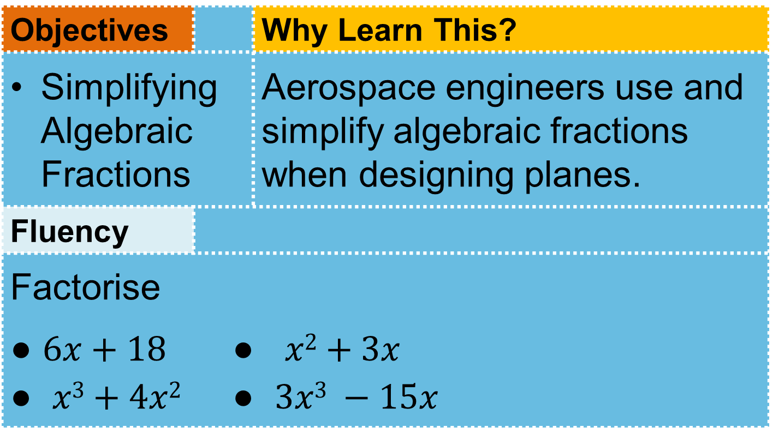
17.3 - Simplifying Algebraic Fractions
Page 533
Objectives |  | Why Learn This?
Simplifying Algebraic Fractions |  | Aerospace engineers use and simplify algebraic fractions when designing planes.
Fluency
Factorise ● $6x+18$ ● $x2+3x$ ● $x3+4x2$ ● $3x3 −15x$
ActiveLearn - Homework, practice and support: Higher 17.3

Slide 29
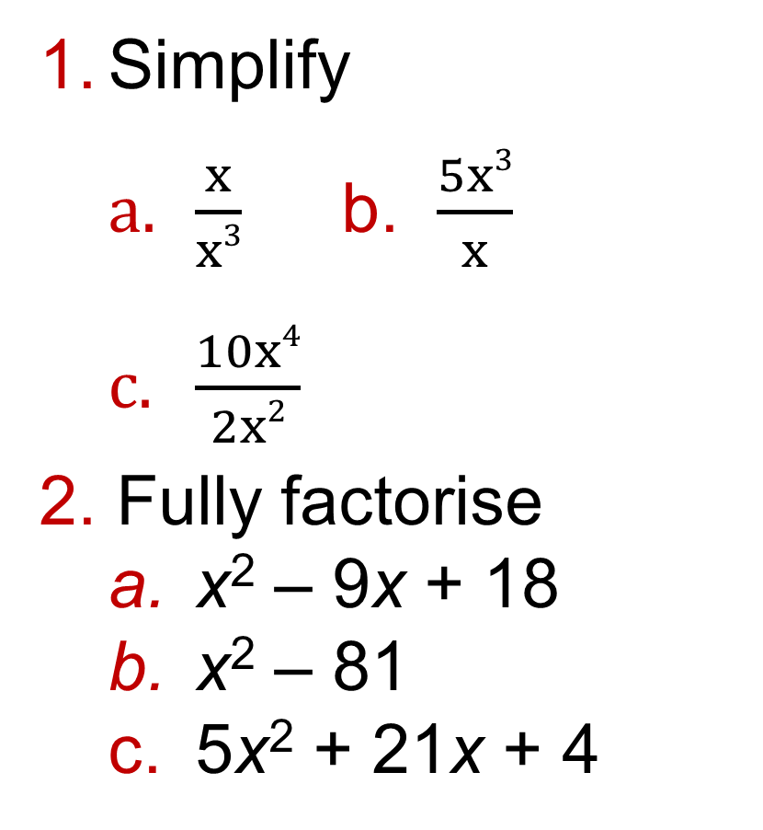
17.3 - Simplifying Algebraic Fractions
Page 535
Simplify
  $\frac{x}{x3}$ b. $\frac{5x3}{x}$
  $\frac{10x4}{2x2}$
Fully factorise
  x² – 9x + 18
  x² – 81
  5x² + 21x + 4
Warm Up

Slide 30
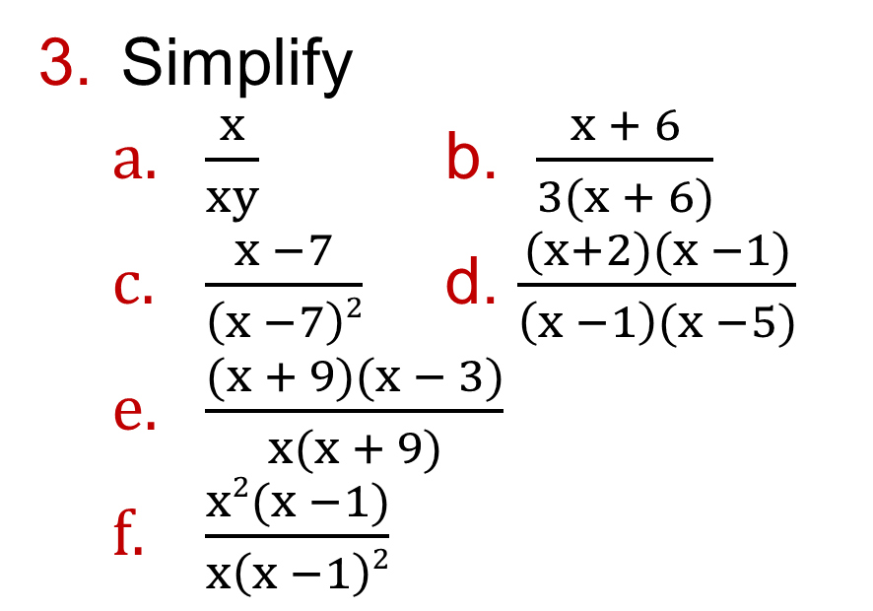
17.3 - Simplifying Algebraic Fractions
Page 535
Simplify
  $\frac{x}{xy}$ b. $\frac{x + 6}{3(x + 6)}$
  $\frac{x −7}{\left(x −7\right)2}$ d. $\frac{(x+2)(x −1)}{\left(x −1\right)(x −5)}$
  $\frac{(x + 9)(x − 3)}{x(x + 9)}$
  $\frac{x2(x −1)}{x\left(x −1\right)2}$
Q3 hint - You can simplify an algebraic fraction ii the same way as simplifying a normal fraction. Cancel any common factors in the numerator and denominator.
Q3c hint - You can only cancel whole brackets.

Slide 31
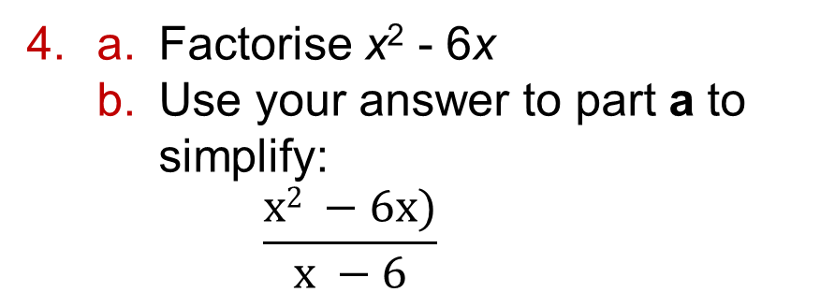
17.3 - Simplifying Algebraic Fractions
Page 535
Key Point 2
You may need to factorise before simplifying an algebraic fraction:
Factorise the numerator and denominator.
Divide the numerator and denominator by any common factors.
a. Factorise x² - 6x
  Use your answer to part a to simplify:
  $\frac{x2 −6x)}{x −6}$
Q4b hint - Replace the numerator with your factorisation from part a. Cancel common factors.

Slide 32
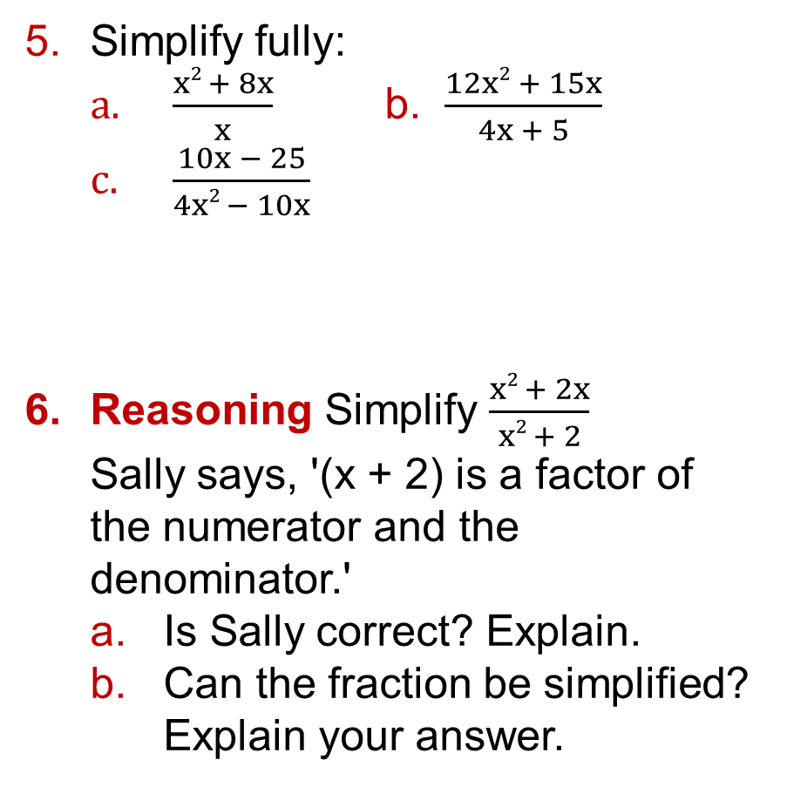
17.3 - Simplifying Algebraic Fractions
Page 536
Simplify fully:
  $\frac{x2 + 8x}{x}$ b. $\frac{12x2 + 15x}{4x + 5}$
  $\frac{10x − 25}{4x2 − 10x}$
Reasoning Simplify $\frac{x2 + 2x}{x2 + 2}$
Sally says, '(x + 2) is a factor of the numerator and the denominator.'
  Is Sally correct? Explain.
  Can the fraction be simplified? Explain your answer.
Q5c hint - Factorise the numerator and denominator.

Slide 33
17.3 - Simplifying Algebraic Fractions
Page 536
Simplify fully:
  $\frac{x2 + 8x}{x}$ b. $\frac{12x2 + 15x}{4x + 5}$
  $\frac{10x − 25}{4x2 − 10x}$
Reasoning Simplify $\frac{x2 + 2x}{x2 + 2}$
Sally says, '(x + 2) is a factor of the numerator and the denominator.'
  Is Sally correct? Explain.
  Can the fraction be simplified? Explain your answer.
Q5c hint - Factorise the numerator and denominator.

Slide 34
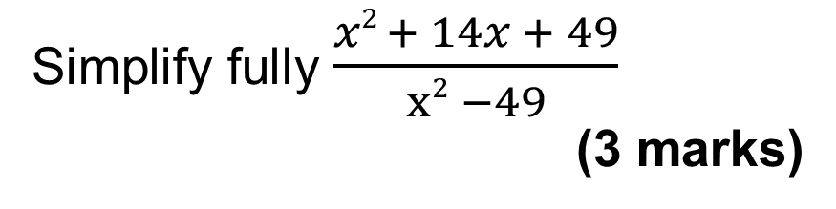
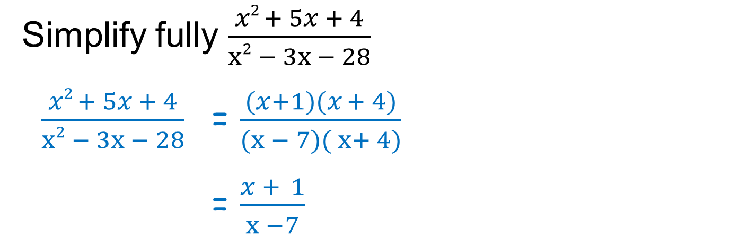
17.3 - Simplifying Algebraic Fractions
Page 536
Example 4
Simplify fully $\frac{x2 + 5x + 4}{x2 − 3x − 28}$
$\frac{x2 + 5x + 4}{x2 − 3x − 28}$ = $\frac{(x+1)(x + 4)}{(x − 7)( x+ 4)}$
= $\frac{x + 1}{x −7}$
Factorise the numerator and denominator
Divide the numerator and denominator x - 1 by the common factor (x + 4).
Exam hint
First factorise the numerator and denominator.
Use the fact that
a² - b² = (a + b)(a - b).
9 – Exam-Style Questions
Simplify fully$\frac{x2 + 14x + 49}{x2 −49}$
(3 marks)

Slide 35
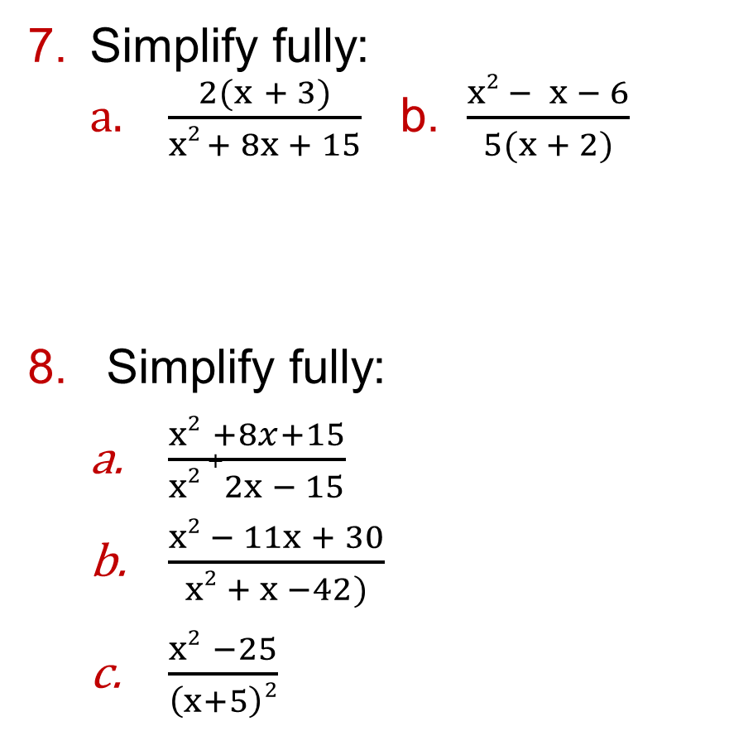
17.3 - Simplifying Algebraic Fractions
Page 536
Simplify fully:
  $\frac{2(x + 3)}{x2 + 8x + 15}$ b. $\frac{x2 − x − 6}{5(x + 2)}$
Simplify fully:
  $\frac{x2 +8x+15}{x2 +2x − 15}$
  $\frac{x2 − 11x + 30}{x2 + x −42)}$
  $\frac{x2 −25}{\left(x+5\right)2}$
Q7a hint - Do not expand the numerator.
Q8c hint - Factorise (x² - 25) using the difference of two squares.

Slide 36
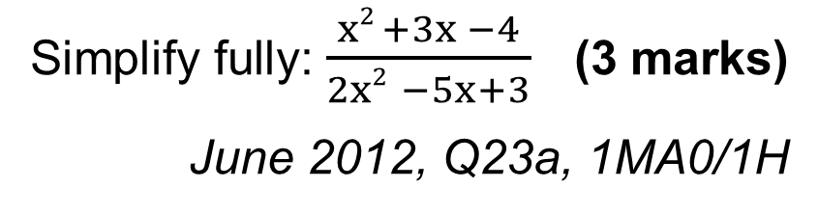
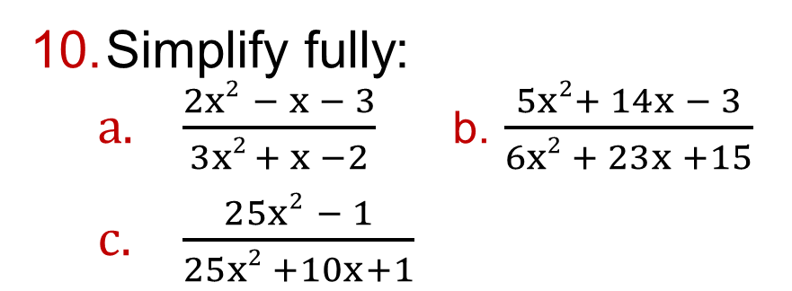
17.3 - Simplifying Algebraic Fractions
Page 536
Simplify fully:
  $\frac{2x2 − x − 3}{3x2 + x −2}$ b. $\frac{5x2+ 14x − 3}{6x2 + 23x +15}$
  $\frac{25x2 − 1}{25x2 +10x+1}$
11 – Exam-Style Questions
Simplify fully: $\frac{x2 +3x −4}{2x2 −5x+3}$ (3 marks)
June 2012, Q23a, 1MA0/1H
Exam hint - 1 mark is awarded For correctly factorising the numerator; 1 mark for factorising the denominator; and 1 mark for the correct Final answer.

Slide 37
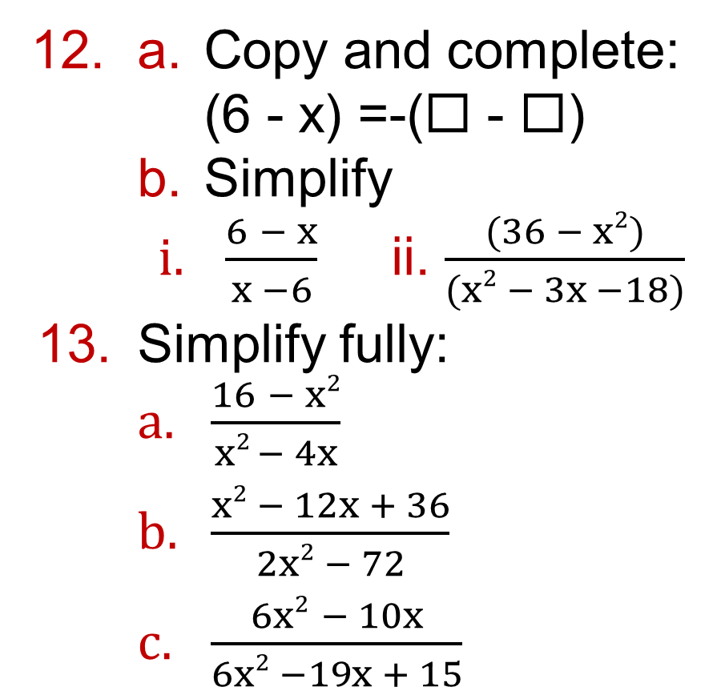
17.3 - Simplifying Algebraic Fractions
Page 536
a. Copy and complete:
(6 - x) =-(◻ - ◻)
  Simplify
    $\frac{6 − x}{x −6}$ ii. $\frac{(36 − x2)}{(x2 − 3x −18)}$
Simplify fully:
  $\frac{16 − x2}{x2 − 4x}$
  $\frac{x2 − 12x + 36}{2x2 − 72}$
  $\frac{6x2 − 10x}{6x2 −19x + 15}$

Slide 38

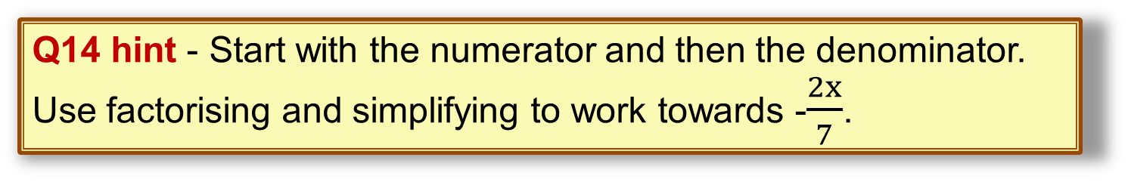
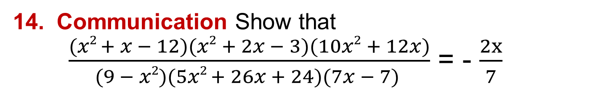
17.3 - Simplifying Algebraic Fractions
Page 537
Communication Show that
  $\frac{(x2 + x − 12)(x2 + 2x − 3)(10x2 + 12x)}{(9 − x2)(5x2 + 26x + 24)(7x − 7) }$ = - $\frac{2x}{7}$
Q14 hint - Start with the numerator and then the denominator. Use factorising and simplifying to work towards -$\frac{2x}{7}$.

Slide 39
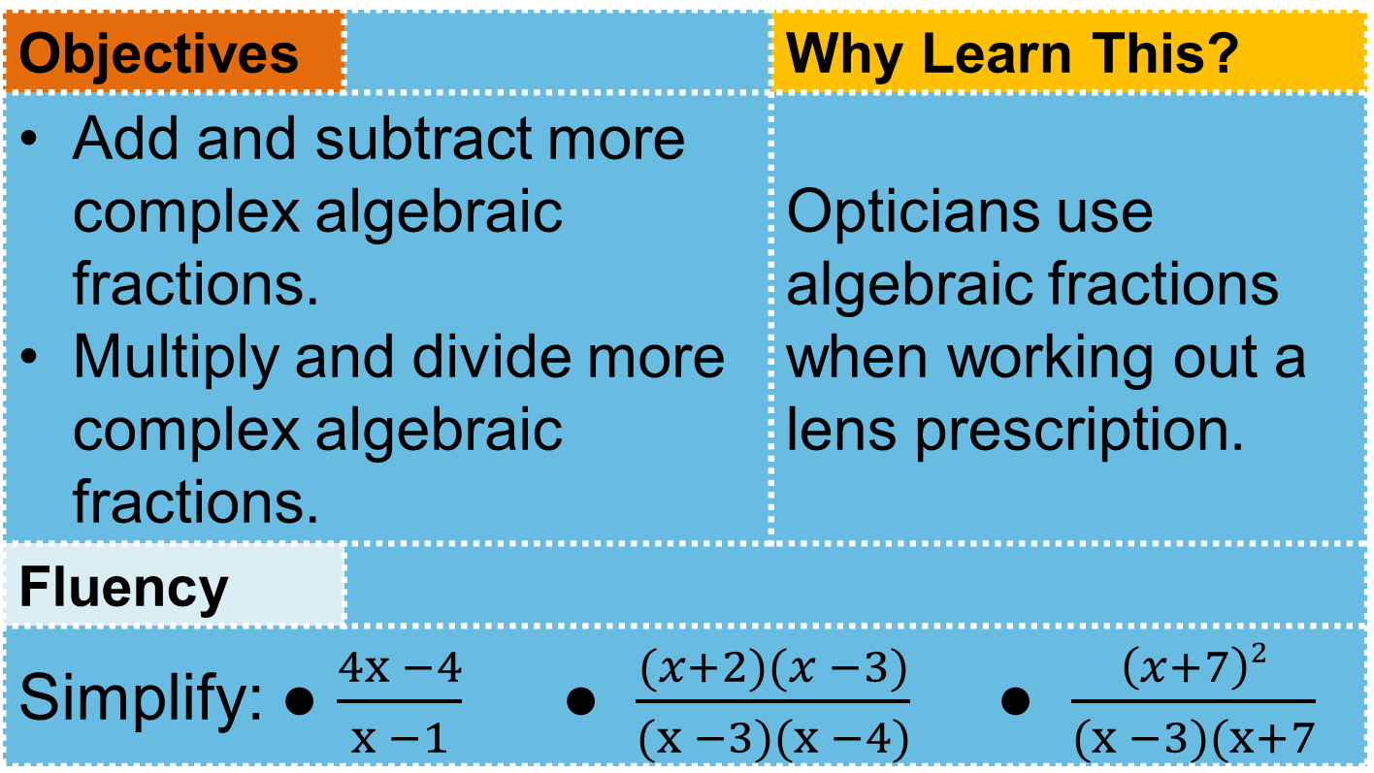
17.4 - More Algebraic Fractions
Page 537
Objectives |  | Why Learn This?
Add and subtract more complex algebraic fractions. Multiply and divide more complex algebraic fractions. |  | Opticians use algebraic fractions when working out a lens prescription.
Fluency
Simplify: ● $\frac{4x −4}{x −1}$ ● $\frac{(x+2)(x −3)}{(x −3)(x −4)}$ ● $\frac{\left(x+7\right)2}{(x −3)(x+7}$
ActiveLearn - Homework, practice and support: Higher 17.4

Slide 40
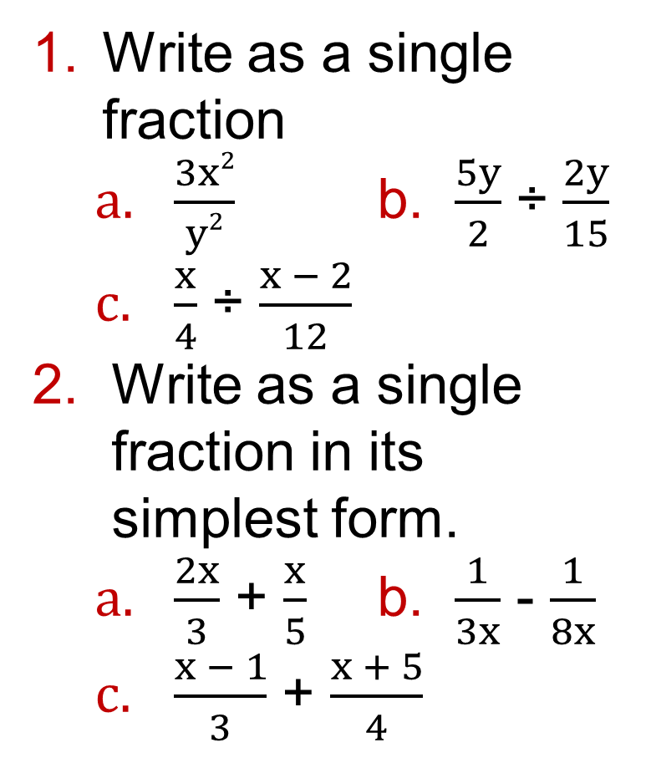
17.4 – More Algebraic Fractions
Page 537
Write as a single fraction
  $\frac{3x2}{y2}$ b. $\frac{5y}{2}$ ÷ $\frac{2y}{15}$
  $\frac{x}{4}$ ÷ $\frac{x − 2}{12}$
Write as a single fraction in its simplest form.
  $\frac{2x}{3}$ + $\frac{x}{5}$ b. $\frac{1}{3x}$ - $\frac{1}{8x}$
  $\frac{x − 1}{3}$ + $\frac{x + 5}{4}$
Warm Up

Slide 41
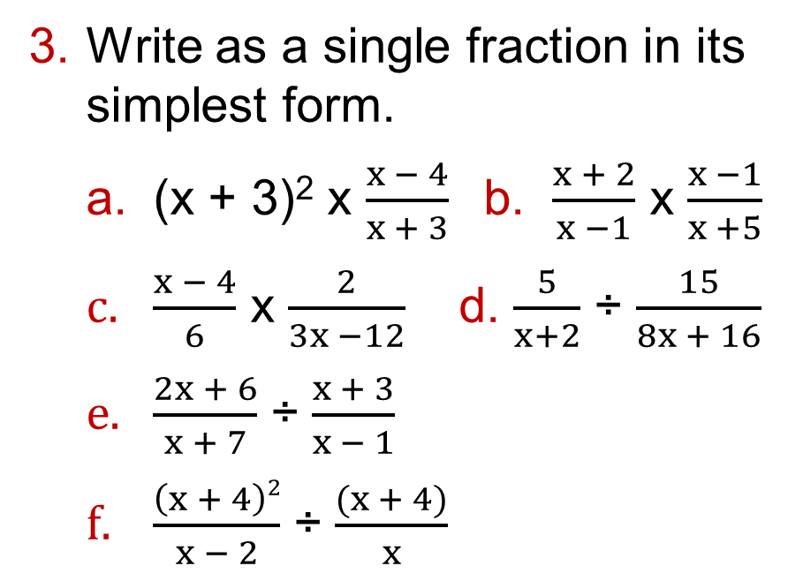
17.4 – More Algebraic Fractions
Page 537
Write as a single fraction in its simplest form.
  (x + 3)² x $\frac{x − 4}{x + 3}$ b. $\frac{x + 2}{x −1}$ x $\frac{x −1}{x +5}$
  $\frac{x − 4}{6}$ x $\frac{2}{3x −12}$ d. $\frac{5}{x+2}$ ÷ $\frac{15}{8x + 16}$
  $\frac{2x + 6}{x + 7}$ ÷ $\frac{x + 3}{x − 1}$
  $\frac{\left(x + 4\right)2}{x − 2}$ ÷ $\frac{(x + 4)}{x}$
Key Point 3
You may need to factorise the numerator and/or denominator before you multiply or divide algebraic fractions.
Q3c hint - First factorise 3x - 12.

Slide 42
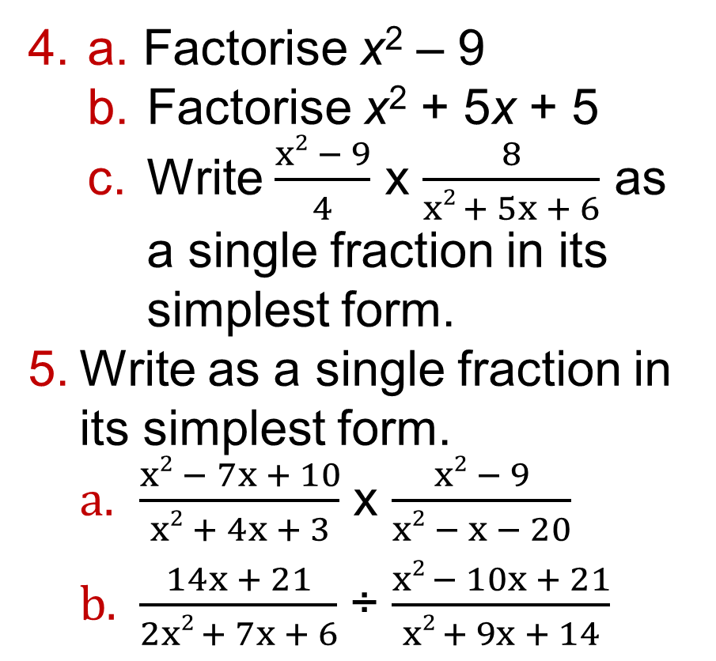
17.4 – More Algebraic Fractions
Page 537
a. Factorise x² – 9
  Factorise x² + 5x + 5
  Write $\frac{x2 − 9}{4}$ x $\frac{8}{x2 + 5x + 6}$ as a single fraction in its simplest form.
Write as a single fraction in its simplest form.
  $\frac{x2 − 7x + 10}{x2 + 4x + 3}$ x $\frac{x2 − 9}{x2 − x − 20}$
  $\frac{14x + 21}{2x2 + 7x + 6}$ ÷ $\frac{x2 − 10x + 21}{x2 + 9x + 14}$

Slide 43
17.4 – More Algebraic Fractions
Page 537
Write down the LCM of
  x and x + 2
  x + 2 and x + 3
  x + 4 and x + 5
  x + 1 and x - 1
  2x - 3 and 2x - 4

Slide 44
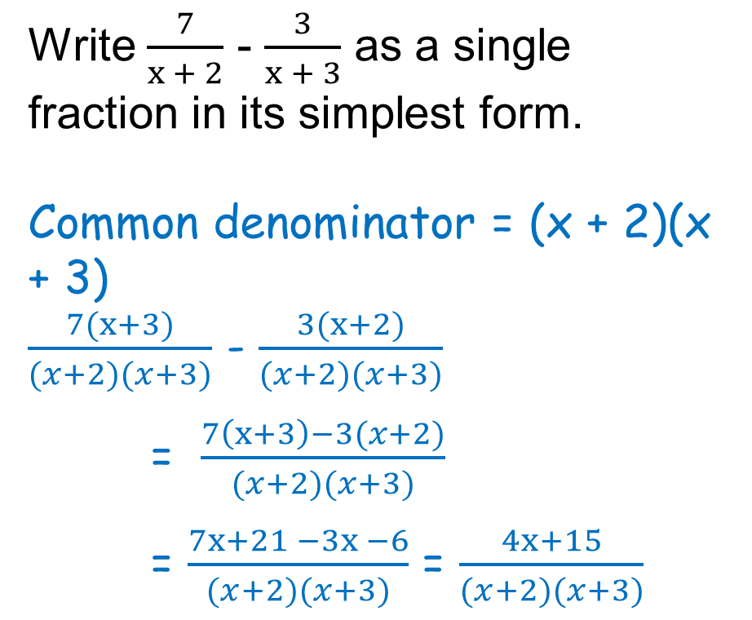
17.4 – More Algebraic Fractions
Page 538
Example 5
Write $\frac{7}{x + 2}$ - $\frac{3}{x + 3}$ as a single fraction in its simplest form.
Common denominator = (x + 2)(x + 3)
$\frac{7(x+3)}{(x+2)(x+3)}$ - $\frac{3(x+2)}{(x+2)(x+3)}$
= $\frac{7\left(x+3\right)−3(x+2)}{(x+2)(x+3)}$
= $\frac{7x+21 −3x −6}{(x+2)(x+3)}$ = $\frac{4x+15}{(x+2)(x+3)}$
Factorise the numerator and denominator
Convert each fraction to an equivalent fraction with the common denominator (x+2)(x + 3).
Subtract the fractions
Expand the brackets in the numerator, then simplify.

Slide 45
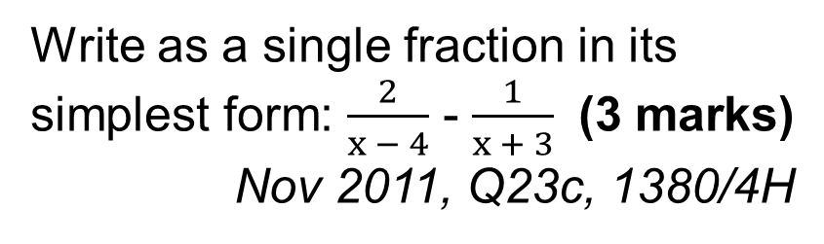
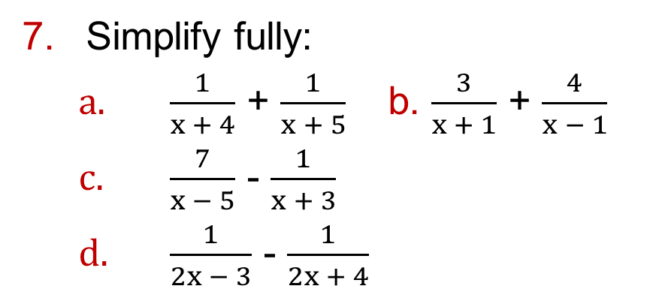
17.4 – More Algebraic Fractions
Page 538
Simplify fully:
  $\frac{1}{x + 4}$ + $\frac{1}{x + 5}$ b. $\frac{3}{x + 1}$ + $\frac{4}{x − 1}$
  $\frac{7}{x − 5}$ - $\frac{1}{x + 3}$
  $\frac{1}{2x − 3}$ - $\frac{1}{2x + 4}$
8 – Exam-Style Questions
Write as a single fraction in its simplest form: $\frac{2}{x − 4}$ - $\frac{1}{x + 3}$ (3 marks)
Nov 2011, Q23c, 1380/4H
Exam hint
Take care when multiplying out a bracket which has a negative sign in front of it.

Slide 46
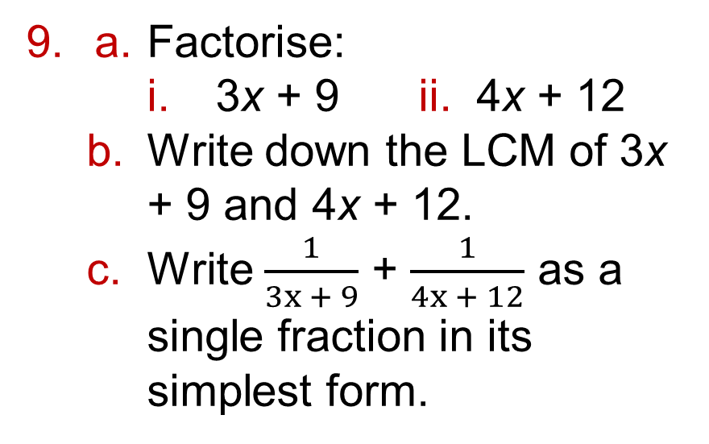
17.4 – More Algebraic Fractions
Page 538
a. Factorise:
    3x + 9 ii. 4x + 12
  Write down the LCM of 3x + 9 and 4x + 12.
  Write $\frac{1}{3x + 9}$ + $\frac{1}{4x + 12}$ as a single fraction in its simplest form.
Q9b hint - Look at the factorised form of each expression:
a(x + y)
b(x + y)
LCM = ab(x + y)

Slide 47
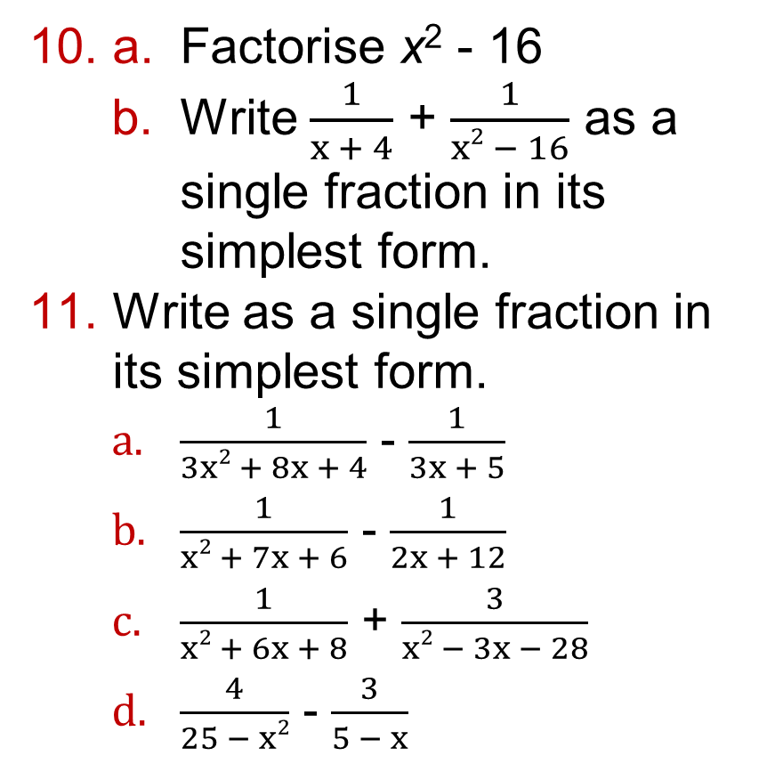
17.4 – More Algebraic Fractions
Page 538
a. Factorise x² - 16
  Write $\frac{1}{x + 4}$ + $\frac{1}{x2 − 16}$ as a single fraction in its simplest form.
Write as a single fraction in its simplest form.
  $\frac{1}{3x2 + 8x + 4}$ - $\frac{1}{3x + 5}$
  $\frac{1}{x2 + 7x + 6}$ - $\frac{1}{2x + 12}$
  $\frac{1}{x2 + 6x + 8}$ + $\frac{3}{x2 − 3x − 28}$
  $\frac{4}{25 − x2}$ - $\frac{3}{5 − x}$
Q11b hint - Factorise (x² + 7x + 6) and (2x + 12).

Slide 48
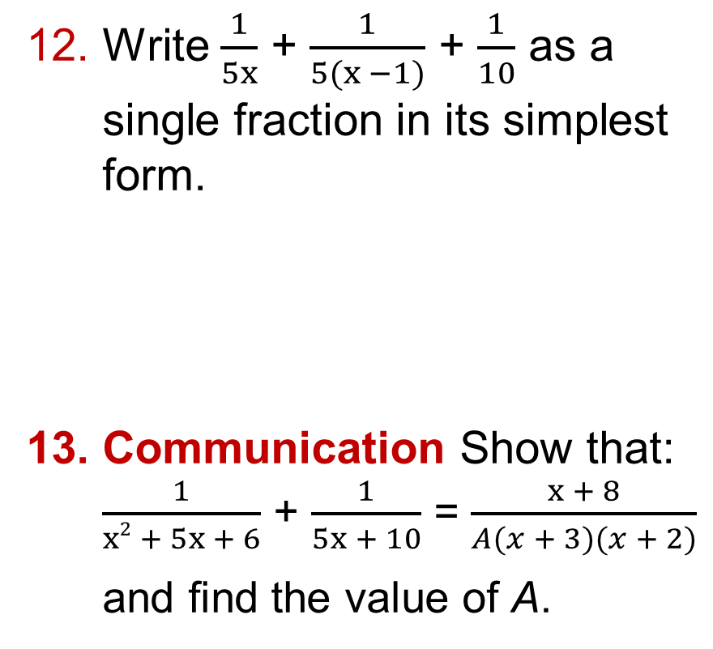
17.4 – More Algebraic Fractions
Page 538
Write $\frac{1}{5x}$ + $\frac{1}{5(x −1)}$ + $\frac{1}{10}$ as a single fraction in its simplest form.
Communication Show that:
$\frac{1}{x2 + 5x + 6}$ + $\frac{1}{5x + 10}$ = $\frac{x + 8}{A(x + 3)(x + 2)}$
and find the value of A.
Q12 hint - Work out the lowest common denominator of 5x, 5(x - 1) and 10.

Slide 49
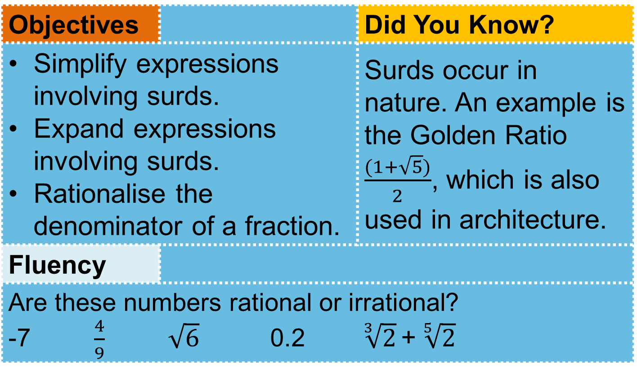
17.5 - SURDS
Page 539
Objectives |  | Did You Know?
Simplify expressions involving surds. Expand expressions involving surds. Rationalise the denominator of a fraction. |  | Surds occur in nature. An example is the Golden Ratio $\frac{(1+\sqrt{5})}{2}$, which is also used in architecture.
Fluency
Are these numbers rational or irrational? -7 $\frac{4}{9}$ $\sqrt{6}$ 0.2 $\sqrt[3]{2}$ + $\sqrt[5]{2}$
ActiveLearn - Homework, practice and support: Higher 17.5

Slide 50



17.5 – Surds
Page 539
Workout
  $\sqrt{5}$ x $\sqrt{5}$ b. 7$\sqrt{3}$ - 4$\sqrt{3}$
  3$\sqrt{2}$ + 5$\sqrt{2}$
Copy and complete.
  $\sqrt{6}$ = $\sqrt{2}$ x $\sqrt{◻}$
  $\sqrt{◻}$ = $\sqrt{5}$ x $\sqrt{6}$
  $\sqrt{\frac{[ ]}{[ ]}}$ = $\frac{\sqrt{5}}{\sqrt{7}}$
Warm Up
Q2a hint - Use $\sqrt{m}$ x $\sqrt{n}$ = $\sqrt{mn}$
Q2c hint - Use$\frac{\sqrt{m}}{\sqrt{n}}$ = $\sqrt{\frac{m}{n}}$

Slide 51

17.5 – Surds
Page 539
Find the value of the integer k.
  $\sqrt{50}$ = $\sqrt{◻}$ x $\sqrt{2}$ = k$\sqrt{2}$
  $\sqrt{18}$ = k$\sqrt{2}$
  $\sqrt{48}$ = $k\sqrt{3}$
Rationalise the denominators. Simplify your answers if possible.
  $\frac{1}{\sqrt{10}}$ b. $\frac{3}{\sqrt{15}}$
  $\frac{8}{\sqrt{32}}$
Warm Up

Slide 52


17.5 – Surds
Page 539
Simplify
  i. $\sqrt{45}$ ii. $\sqrt{20}$
  Use your answers to part a to simplify
  3$\sqrt{45}$ -+ 7$\sqrt{20}$
Simplify
  2$\sqrt{75}$ - 3$\sqrt{27}$
  $\sqrt{200}$ + 3$\sqrt{32}$
  5$\sqrt{18}$ - $\sqrt{128}$ +4$\sqrt{8}$
Q6a hint - First simplify each surd.
$\sqrt{75}$ = k$\sqrt{3}$, l$\sqrt{3}$

Slide 53


17.5 – Surds
Page 539
Simplify
  $\sqrt{12}$+ 2 = 2$\sqrt{◻}$ + 2
  = 2($◻$ + $◻$)
  9 + $\sqrt{54}$ c. 18 - $\sqrt{45}$
  $\sqrt{75}$ - $\sqrt{50}$
Expand and simplify:
  $\sqrt{5}$(4 + $\sqrt{5})$
  ($\sqrt{7}$ + 1)(4 + $\sqrt{7}$)
  (6 - $\sqrt{2}$)(4 + $\sqrt{2}$)
  (2 - $\sqrt{2}$)² e. (4 - $\sqrt{10}$)²
  (7 + $\sqrt{3})$²
Q8d hint - (2 - $\sqrt{2}$)² = (2 - $\sqrt{2}$ )(2 - $\sqrt{2}$) Your answer should be in the form a - b$\sqrt{2}$.

Slide 54


17.5 – Surds
Page 539
9 – Exam-Style Questions
Expand (5 - $\sqrt{5}$)². Write your answer in the form a + b$\sqrt{c}$ y where a, b and c are integers. (2 marks)
Rationalise the denominators. The first one has been started for you.
  $\frac{3 x \sqrt{2}}{\sqrt{2}}$ x $\frac{\sqrt{2}}{\sqrt{2}}$ = $\frac{3 x \sqrt{2} x \sqrt{2}}{\sqrt{2} x \sqrt{2}}$ =
  $\frac{6 − \sqrt{3}}{\sqrt{3}}$ c. $\frac{19 − \sqrt{7}}{\sqrt{7}}$
  $\frac{5 + \sqrt{5}}{\sqrt{5}}$

Slide 55


17.5 – Surds
Page 540
a. Work out the area of each shape. Write your answers in the form
a + b$\sqrt{c}$.
  Reasoning Would the perimeter of each shape be rational or irrational? Explain.

Slide 56


17.5 – Surds
Page 540
Reasoning a. Expand and simplify
(3 + $\sqrt{5}$)(3 - $\sqrt{5}$)
  Is your answer rational or irrational?
  How can you tell if your answer will be rational or irrational?
  Which of these will have rational answers when expanded?
    (7 + $\sqrt{2}$)(2 - $\sqrt{2}$)
    (7+ $\sqrt{2}$)(7 + $\sqrt{2}$)
    (7 + $\sqrt{2}$)(7 - $\sqrt{2}$)
    Check by expanding the brackets.
  Rationalise the denominator of $\frac{1}{(7+\sqrt{2})}$
Q13e hint - Multiply the numerator and denominator by (7 - $\sqrt{2}$).

Slide 57



17.5 – Surds
Page 540
12 – Exam-Style Questions
Given that $\frac{\text{8} \text{−}\sqrt{18}}{\sqrt{2}}$ = a + b$\sqrt{2}$, where a and b are integers, find the value of a and the value of b. (3 marks)
June 2011, Q22b, 1380/3H
Exam hint
Make sure you multiply both parts of the expression in the numerator by $\sqrt{2}$.
Key Point 4
To rationalize the fraction $\frac{1}{a\sqrt{b}}$, multiply by $\frac{\sqrt{b}}{\sqrt{b}}$
To rationalize the fraction $\frac{1}{a \text{±} \sqrt{b}}$, multiply by $\frac{a \text{±} \sqrt{b}}{a \text{±} \sqrt{b}}$

Slide 58


17.5 – Surds
Page 540
Reasoning a. Rationalise the denominators. Give your answers in the form a ± $\sqrt{b}$ or a ± b$\sqrt{c}$ where a, b and c are rational
  $\frac{1}{1 + \sqrt{2}}$ b. $\frac{1}{5 − \sqrt{3}}$ c. $\frac{7}{4 − \sqrt{5}}$
  $\frac{1}{1 + \sqrt{6}}$ e. $\frac{\sqrt{5}}{1 − \sqrt{5}}$ f. $\frac{6 + \sqrt{2}}{8 − \sqrt{2}}$
a. Solve x² - 6x + 1 = 0 by using the quadratic formula.
  Solve the equation x² +10x + 13 = 0 by completing the square,
  Solve the equation x² -16x +8 = 0. Write all your answers in surd form.
Q14a hint - Multiply the numerator and denominator by (1 - $\sqrt{2}$).
Q15a hint - Simplify your surd answer.

Slide 59
17.6 – Solving Algebraic Fraction Equations
Page 541
Objectives |  | Why Learn This?
Solve equations that involve algebraic fractions. |  | Pharmacists use algebraic fraction equations to calculate the correct dosage when issuing medication.
Fluency
Find the LCM of x and 4 4x and x x + 3 and x + 2
ActiveLearn - Homework, practice and support: Higher 17.6

Slide 60

17.6 – Solving Algebraic Fraction Equations
Page 541
Simplify
  (x + 3)(x - 2) x $\frac{2}{(x − 2)}$
  (x + 6)(x + 4) x $\frac{4}{(x + 6)}$
Write as a single fraction in its simplest form.
  $\frac{6}{x}$ - $\frac{1}{x}$ b. $\frac{7}{2x}$ - $\frac{3}{2x}$
  $\frac{8}{x −6}$ + $\frac{2}{x −6}$
Solve by factorizing:
  x² + 6x + 8 = 0
  2x²- 13x +11 = 0
  5x² – 25x + 20 = 0
Solve 3x² + 8x - 17 = 0 by using the quadratic formula. Give your answers correct to 2 decimal places.
Warm Up

Slide 61

17.6 – Solving Algebraic Fraction Equations
Page 541
Solve these equations. Give your answer as a simplified fraction:
  $\frac{3}{x}$ + $\frac{2}{x}$ = 4 b. $\frac{6}{x − 1}$ - $\frac{2}{x − 1}$ = 7
  8 = $\frac{3}{x + 5}$ - $\frac{7}{x + 5 }$
Solve these quadratic equations
  $\frac{4}{x}$ = $\frac{3x −7}{5}$ = 4 b. $\frac{2x + 1}{3}$ = $\frac{2}{x}$
  $\frac{5x − 3}{2}$ = $\frac{7}{x }$ d. $\frac{10}{x }$ = $\frac{2x + 3}{2 }$
Q5a hint - First simplify the LHS of the equation.
Q6a hint - First multiply both sides by the LCM (5x) and simplify. Then multiply out the bracket and solve by factorising..

Slide 62

17.6 – Solving Algebraic Fraction Equations
Page 541
Example 5
Solve: $\frac{3}{2x − 1}$ + $\frac{4}{x+2}$ = 2
$\frac{3(x + 2)}{(2x − 1)(x + 2)}$ + $\frac{4(2x − 1)}{(x + 2)(2x − 1}$ = 2
$\frac{3\left(x + 2\right) + 4(2x − 1)}{(2x − 1)(x + 2)}$ = 2
$\frac{3x + 6 + 8x − 4}{(2x − 1)(x+2)}$ = $\frac{11x + 2}{(2x − 1)(x + 2)}$ = 2
11x + 2 = 2(2x - 1)(x + 2)
11x + 2 = 4x² + 6x – 4
4x² – 5x – 6 = 0
(4x + 3)(x - 2) = 0, so either 4x + 3 = 0 or x - 2 = 0
The solutions are x = -$\frac{3}{4}$ and x = 2.
Rewrite the LHS using the common denominator (2x - 1)(x + 2)
Add the fractions
Expand the brackets in the numerator and simplify
Multiply both sides by (2x - 1)(x + 2).
Multiply out the brackets and simplify the right-hand side.
Rearrange into the form ax² + bx + c = 0
Solve by factorising

Slide 63

17.6 – Solving Algebraic Fraction Equations
Page 542
Copy and complete Sioned's working to solve: $\frac{3}{x + 1}$ + $\frac{2}{2x −3}$ = 1
$\frac{3(x+1)(2x −3)}{x + 1}$ + $\frac{2(x+1)(2x −3)}{2x −3}$ = 1(x + 1)(2x - 3)
3(2x -3) +2(x + 1) = (x + 1)(2x - 3)
6x – 9 + 2x +2 =
Reflect Sioned has used a different method to the example. Which method do you prefer? Why?
Multiply all the terms by the common denominator (x + 1)(2x - 3) and simplify
Simplify both sides and expand the brackets.
Rearrange into the form ax² + bx + c = 0

Slide 64


17.6 – Solving Algebraic Fraction Equations
Page 542
Communication
  Show that the equation
  $\frac{x}{2x − 3}$ + $\frac{x}{2x − 3}$ = 1 can be rearranged to give x² -10x + 9 = 0
  Solve x² -10x + 9 = 0
  Discussion How can you check your solution is correct?
11 – Exam-Style Questions
Find the exact solutions of x + $\frac{5}{x}$ = 12
(3 marks)
Exam hint
“Find the exact solutions of” means that you should not use a calculator. You should give your answers using simplified surds.

Slide 65

17.6 – Solving Algebraic Fraction Equations
Page 542
Solve these quadratic equations.
  $\frac{1}{x − 1}$ + $\frac{1}{5 − x}$ = 1
  $\frac{5}{x + 2}$ + $\frac{3}{x − 2}$ = 1
  $\frac{4}{x}$ - $\frac{3}{2x −1}$ = 1
  $\frac{3}{x + 1}$ - $\frac{2}{x + 3}$ = 1
  $\frac{4}{x}$ - $\frac{2}{2x + 3}$ = 1

Slide 66

17.6 – Solving Algebraic Fraction Equations
Page 542
Solve these quadratic equations.
Give your answers correct to 2 decimal places.
  $\frac{4x − 1}{2 − x}$ = $\frac{x}{3}$
  $\frac{1}{x − 1}$ + $\frac{1}{x + 2}$ = 5
  $\frac{4}{x}$ - $\frac{2}{1 − x}$ = 1
  $\frac{2}{x − 5}$ + $\frac{1}{x + 1}$ = 3
Q10 communication hint - Give your answers correct to 2 decimal places' shows that you will need to use the quadratic formula.

Slide 67
17.7 – Functions
Page 543
Objectives |  | Why Learn This?
Use function notation. Find composite functions. Find inverse functions. |  | Function notation is an easy way to distinguish different equations; each can be labelled using different letters.
Fluency
x → → → y What is the output when ● x = 3 ● x = -2 ● x = 5?
squared
X 3
ActiveLearn - Homework, practice and support: Higher 17.7

Slide 68

17.7 – Functions
Page 543
Write each expression using function machines.
  2x + 5
  $\frac{x}{2}$ - 6 c. 3(x + 1)
Find the value of x when
  5x – 3 = 4
  7x - 8 = 8
Warm Up

Slide 69

17.7 – Functions
Page 543
a. H = 4x and x = 3t. Write H in terms of t.
  P = $\frac{x}{3}$ and x = ½y. Write P in terms of y.
  y = x² and x = h + 3. Write y in terms of h.
Q3a hint - Substitute x = 3t into H = 4x.
Key Point 5
A function is a rule for working out values of y for given values of x.
For example, y = 3x and y = x² are functions. The notation f(x) is read as 'f of x', f is the function. f(x) = 3x means the function of x is 3x.

Slide 70


17.7 – Functions
Page 543
f(x) = $\frac{10}{x}$. Work out:
  f(5) b. f(-2)
  f(½) d. f(-20)
Reasoning h(x) = 5x². Alice says that h(2) = 100.
  Explain what Alice did wrong.
  Work out h(2).
Q4a hint - Substitute x = 5 into $\frac{10}{x}$.

Slide 71

17.7 – Functions
Page 543
g(x) = 2x³. Work out
  g(3) b. g(-1)
  g(½) d. g(-5)
f(x) = x + x³, g(x) = 3x². Work out
  f(1) + g(1) b. f(4) - g(2)
  f(2) x g(4)
  $\frac{g(5)}{f(3)}$ e. 2g(10)
  3f(-1) - g(3)
Q6 hint - Use the priority of operations.
Q7e hint - First work out g(10) and then multiply the answer by 2.

Slide 72
17.7 – Functions
Page 543
g(x) = 5x - 3. Work out the value of a when
  g(a) = 12 b. g(a) = 0
  g(a) = -7
f(x) = x² - 8. Work out the values of a when
  f(a) = 17 b. f(a) = -4
  f(a) = 0 d. f(a) = 12
Q8a hint - g(a) = 5a - 3 = 12 Solve for a.
Q9c hint - Write your answer as a surd in its simplest form.

Slide 73
17.7 – Functions
Page 544
f(x) = x(x + 3), g(x) = (x - 1)(x + 5). Work out the values of a when
  f(a) = 0 b. g(a) = 0
  f(a) = -2 d. g(a) = -8
f(x) = 5x - 4. Write out in full
  f(x) + 5 b. f(x) - 9
  2f(x) d. 7f(x)
  f(2x) f. f(4x)
Q10a hint - f(a) = a(a + 3) = 0. Solve for a.
Q11a hint - f(x) + 5 = 5x - 4 + 5 = __
Q11c hint – 2f(x) = 2(5x - 4) = _____
Q11e hint – Replace x by 2x.

Slide 74
17.7 – Functions
Page 544
h(x) = 3x² - 4. Write out in full
  h(x) + 7 b. 2h(x)
  h(2x) d. h(-x)
  Discussion What do you notice about your answer to part d? Explain why this happens.
Key Point 6
fg is a composite function. To work out fg(x), first work out g(x) and then substitute your answer into f(x).

Slide 75
17.7 – Functions
Page 544
Reasoning f(x) = 6 – 2x,
g(x) = x² + 7. Work out
  gf(2) b. gf(7)
  fg(4) d. fg(5)
Reasoning f(x) = 4x - 3, g(x) = 10 - x, h(x) = x² + 7. Work out
  gf(x) b. fg(x)
  fh(x) d. hf(x)
  gh(x) f. hg(x)
Q13a hint - First work out f(2) and then substitute your answer into g(x).
Q14a hint – gf(x) means substitute f(x) for x in g(x). gf(x) = g(4x - 3) = 10 - (4x - 3) = ___

Slide 76

17.7 – Functions
Page 544
Key Point 6
The inverse function reverses the effect of the original function.
Example 5
Find the inverse function of x → 5x - 1
x → → → 5x - 1
$\frac{x + 1}{5}$ ← ← ← x
The inverse function of x → 5x - 1 is x → $\frac{x + 1}{5}$
Communication hint - x → 5x - 1 is another way of showing f(x) = 5x - 1
X5
- 1
Write the function as a function machine.
÷ 5
+ 1
Reverse the function machine to find the inverse function. Start with x as the input

Slide 77

17.7 – Functions
Page 544
Find the inverse of each function.
  x → 4x + 9
  x → $\frac{x}{3}$ - 4
  x → 2(x + 6)
  x → 7(x – 4) - 1
Q15a hint - You can check your answer by substituting e.g. x = 2 into the original function and then the answer into the inverse.
Q15d hint – Simplify the function first. x → 7(x - 4) - 1 is the same as
x → 7x - 29

Slide 78
17.7 – Functions
Page 544
Key Point 8
f⁻¹(x) is the inverse of f(x)
Reasoning f(x) = 4(x - 1), g(x) = 4(x + 1)
  Find f⁻¹(x).
  Find g⁻¹(x).
  Work out f⁻¹(x) + g⁻¹(x).
  If f⁻¹(a) + g⁻¹(a) = 1 work out the value of a.

Slide 79
17.8 – Proof
Page 545
Objectives |  | Did You Know?
Prove a result using algebra |  | In the 1990s, Andrew Wiles spent over seven years trying to prove Fermat's Last Theorem. He received a knighthood for his successful proof.
Fluency
What type of number is a. 2n b. 2n + 1 for any n?
ActiveLearn - Homework, practice and support: Higher 17.8

Slide 80
17.8 – Proof
Page 545
Which sequences contain
    only even numbers
    only odd numbers
  n + 2 b. 2n
  5n d. 2n – 1
  n²
Expand and simplify,
  x(x -1) b. (x + 3)²
  2x(2x + 1)
Are these equations or identities?
  2(n + 3) = 2n + 6
  5n - 7 = 8
  ½(4n +10) = 2n + 5
Warm Up

Slide 81
17.8 – Proof
Page 545
Key Point 6
To show a statement is an identity, expand and simplify the expressions on one or both sides of the equals sign, until the two expressions are the same.
Example 8
Show that (x + 4)2 - 7 - x2 + 8x + 9
LHS = (x + 4)² - 7 = (x + 4)(x + 4) - 7 = x² + 8x + 16 - 7
= x² + 8x + 9
RHS = x² + 8x + 9
So LHS = RHS and (x + 4)² - 7
≡ x² + 8x + 9
Expand the brackets on the left-hand side (LHS).
Aim to show that LHS = RHS.

Slide 82
17.8 – Proof
Page 545
Communication Show that
  (x – 3)² + 6x ≡ x² + 9
  x² + 8x + 49 ≡ (x + 7)² - 6x
  (x - 5)² - 4 ≡ (x - 3)(x - 7)
  16 – (x + 2)² ≡ (6 + x)(2 - x)
  Reflect For part c can you think of a different method than the one given in the hint?
Communication / Reasoning
  Show that (x - 1)(x + 1) ≡ x² - 1
  Use your rule to work out
    99 x 101 ii. 199 x 201
Q4b hint – Start with RHS
Q4c hint – First expand and simplify the LHS. Then factorise.

Slide 83

17.8 – Proof
Page 545
Reasoning The blue card is a rectangle of length x + 5 and width x + 2.
  Write an expression for the area of the blue card.
  A rectangle of length x + 1 and width x is cut out and removed.
  Write an expression for the area of the rectangle cut out.
  Show that the area of the remaining card is 6x + 10.
Q6c hint – Subtract your expression from part b from your expression from part a.

Slide 84

17.8 – Proof
Page 546
7 – Exam-Style Questions
The diagram shows a large rectangle of length (3x + 4)cm and width x cm. A smaller rectangle of length x cm and width 5 cm is cut out and removed. The area of the shape that is left is 70 cm².
Show that 3x² - x - 70 = 0. (3 marks)
Exam hint
‘Show that...‘ means you need to write down every stage of your working.

Slide 85
17.8 – Proof
Page 546
Give a counter-example to prove that these statements are not true,
  All prime numbers are odd.
  The cube of a number is always greater than its square,
  The difference between two numbers is always less than their sum.
  The difference between two square numbers is always odd.
Q8a hint – List some prime numbers
Q8c hint – Try some negative numbers.

Slide 86
17.8 – Proof
Page 546
Key Point 10
A proof is a logical argument for a mathematical statement. To prove a statement is true, you must show that it will be true in all cases.
To prove a statement is not true you can find a counter-example - an example that does not fit the statement.
Communication / Reasoning
  Prove that the sum of any odd number and any even number is always odd.
  Reasoning Explain why any odd number can be written as 2n +1 or 2n -1.
Q9a hint – Let 2n be any even number. Let 2n + 1 be any odd number.

Slide 87
17.8 – Proof
Page 546
Communication / Reasoning
  The nth even number is 2n. Explain why the next even number is 2n + 2.
  Prove that the product of two consecutive even numbers is a multiple of 4.
Communication / Reasoning Prove that the product of any two odd numbers is odd.
Communication / Reasoning Given that 2(x - a) = x + 5, where a is an integer, show that x must be an odd number.

Slide 88

17.8 – Proof
Page 546
Communication / Reasoning
  Work out
    $\frac{1}{5}$ - $\frac{1}{6}$ ii. $\frac{1}{3}$ - $\frac{1}{4}$ iii. $\frac{1}{7}$ - $\frac{1}{8}$
  Use your answers to part a to write down the answer to $\frac{1}{9}$ - $\frac{1}{10}$
  Reasoning Explain how you can quickly calculate $\frac{1}{99}$ - $\frac{1}{100}$
  i. Simplify $\frac{1}{x}$ - $\frac{1}{x + 1}$
    Reasoning Explain how this proves your answer from part c.

Slide 89

17.8 – Proof
Page 547
Communication / Reasoning Show that:
$\frac{1}{x2 −x}$ - $\frac{1}{x2+3x}$ = $\frac{1}{x(x+1)(x+3)}$ and find the value of A.
Communication / Reasoning Prove that
n² + n is a multiple of 2 for all values of n.
Q15 hint – Factorise first

Slide 90
17.8 – Proof
Page 547
Communication
  Write an expression for the product of three consecutive integers, n - 1, n and n + 1.
  Hence show that n³ - n is a multiple of 2.
Q16b hint – Consider when n is even and when n is odd.
17 – Exam-Style Questions
Prove algebraically that the difference between the squares of any two consecutive integers is equal to the sum of these two integers. (4 marks)
February 2013, Q21, IMA0/1H
Q17 strategy hint - Start by using algebra to write down expressions for the squares of two numbers that are consecutive.

Slide 91


17.8 – Proof
Page 548
Objectives | Be able to rearrange equations that involve powers. Be able to use standard form in calculations.
  Big objects, like planets, create gravity that pull objects towards them. This is strongest on the surface of the planet.
  To find the surface gravity of a planet we can use the formula:
  The formula uses a gravitational constant. This is a number that was calculated many years after the formula was constructed.
  G = 6.67 x 10⁻¹¹
g = $\frac{GM}{r2}$ where M = mass of the planet (kg), r = radius of planet (m), G = gravitational constant

Slide 92

17.8 – Proof
Page 548
  Earth's surface gravity is approximately 9.81 m/s². The mass of Earth is 5.97 x 10²⁴ kg. Find the radius of the Earth in kilometres (to 3 significant figures).
  To find the volume of a planet we can assume that it is spherical and use the formula V= $\frac{4}{7}$ π³. The volume of Mars is 1.63 x 10²⁰m³
    Find the radius of Mars (to 3 significant figures).
    Given that the mass of Mars is 6.42 x 10²³ kg, calculate the gravity on the surface of Mars.
Q1 hint - Rearrange the equation to make r the subject
Q2a hint - Rearrange the equation for the volume of the sphere to maker the subject.

Slide 93
17.8 – Proof
Page 548
  The density of Saturn is 687 kg/m³. Its mass is 5.68 x 10²⁶kg. Calculate the gravity at the surface.
  Imagine that the Earth starts growing. Assuming that the Earth's density remained constant, what radius would it need to grow to in order to have the same surface gravity as on Saturn?
Q3 hint - Remember that Density = mass + volume
Q4 hint - Start by combining the equation for the volume of a sphere, the equation for gravity and the equation for density. Remember that as the radius increases so will the mass. Your equation will only involve values that will remain constant (G, D, g and r).

Slide 94


17 – Check-Up
Page 549
16. Check up | Log how you did on your Student Progression Chart
  Surds
  Simplify
    $\sqrt{200}$ + 2$\sqrt{50}$ b. (4-$\sqrt{7}$)²
  Rationalise the denominators.
    $\frac{3 −\sqrt{2}}{\sqrt{5}}$ b. $\frac{3}{2 − \sqrt{3}}$
  Formulae and functions
  Find f ⁻¹(x) for each function,
    f(2) = $\frac{4}{7}$ b. f(x) = 3x + 4

Slide 95

17 – Check-Up
Page 549
  f(x) = 9 – 2x, g(x) = x² + 4x. Work out
    f(2) + g(3)
    f(2) - g(3)
    f(3) x g(4)
    $\frac{g(6)}{f(6)}$
  Make y the subject of the formula z = $\sqrt[3]{\begin{aligned}x+1 \\ y\end{aligned}}$
  Make y the subject of 5xy + 3x = 9 – 2y

Slide 96

17 – Check-Up
Page 549
  Make k the subject of the formula T = 2p$\sqrt{\begin{aligned}x \\ k\end{aligned}}$
  f(x) = 4x² - 7
    Work out f(3).
    Find the value of a where f(a) = 0.
  Algebraic fractions
  Simplify fully:
    $\frac{x2 − 4}{3x + 6}$ b. $\frac{x2 + 4x −32}{x2 + 9x + 8}$

Slide 97

17 – Check-Up
Page 549
  Write as a single fraction in its simplest form.
    $\frac{5}{2x}$ - $\frac{7}{3x}$ b. $\frac{3}{x+4}$ + $\frac{1}{x −5}$
    $\frac{4}{x2 − 7x + 6}$ - $\frac{2}{x − 1}$
  Write as a single fraction in its simplest form.
    $\frac{16x3}{21y9}$ x $\frac{14y4}{12x}$
    $\frac{x2 + 9x − 10}{x2 + 5x + 4}$ ÷ $\frac{4x − 4}{3x + 12}$

Slide 98

17 – Check-Up
Page 549
  Solve the equation
  $\frac{2}{x + 1}$ - $\frac{1}{x + 2}$ = 1
  Proof
  Communication Show that 23 - (x + 1)² = (6 + x)(4 - x)
  Communication / Reasoning Prove that this statement is not true:
  The sum of two cubed numbers is always odd.

Slide 99
17 – Check-Up
Page 549
Reflect
  How sure are you of your
  answers? Were you mostly
    Just guessing ☹
    Feeling doubtful 😐
    Confident ☺
    What next? Use your results to decide whether to strengthen or extend your learning.
  * Challenge
  Prove that
    the sum of two consecutive odd numbers is a multiple of 4
    the sum of three consecutive even numbers is a multiple of 6
    the sum of four consecutive odd numbers is a multiple of 8.
Q16 hint - Let 2n be any even number and 2n + 1 be any odd number.

Slide 100



17 – Strengthen
Page 550
17 - Strengthen
Copy and complete,
  $\sqrt{3}$ x $\sqrt{3}$ = ◻
  $\sqrt{7}$ x $\sqrt{\text{◻}}$ = 7
  2$\sqrt{\text{2}}$ x $\sqrt{\text{2}}$ =0
  $\sqrt{\text{5}}$(6 - $\sqrt{\text{5}}$) = $\sqrt{\text{5}}$x 6 - $\sqrt{\text{5}}$ x $\sqrt{\text{5}}$ = 6$\sqrt{\text{5}}$ - ◻
  $\sqrt{\text{180}}$ + $\sqrt{\text{45}}$
Q1d hint - $\sqrt{\text{5}}$ x 6 = 6 x $\sqrt{\text{5}}$ = 6$\sqrt{\text{5}}$
Always write the whole number before the surd
Q1e hint - $\sqrt{\text{180}}$ = $\sqrt{\text{9 }\text{x}\text{ 4 }\text{x}\text{ 5}}$ and $\sqrt{\text{45}}$ = $\sqrt{\text{◻} \text{x}\text{◻}}$

Slide 101



17 – Strengthen
Page 550
Rationalise the denominators.
  $\frac{12}{\sqrt{3}}$ = $\frac{12}{\sqrt{3}}$ x $\frac{\sqrt{3}}{\sqrt{3}}$ = $\frac{\text{◻} \sqrt{3}}{\text{◻} }$ = ◻$\sqrt{3}$ c. $\frac{8 − \sqrt{5}}{\sqrt{5}}$
  $\frac{4+ \sqrt{11}}{\sqrt{11}}$ = $\frac{4+ \sqrt{11}}{\sqrt{11}}$ x $\frac{\sqrt{11}}{\sqrt{11}}$ = $\frac{4 x \sqrt{11} +\text{◻}}{\sqrt{11} x \text{◻}}$ = $\frac{\text{◻}}{\text{◻}}$
Q2a hint - $\sqrt{\text{3}}$ x $\sqrt{\text{3}}$ = 3. To get rid of $\sqrt{\text{3}}$ in the denominator, multiply the fraction by $\frac{\sqrt{3}}{\sqrt{3}}$
Q2b hint -Multiply both parts of the expression in the numerator by $\sqrt{\text{11}}$
Q2 communication hint - 'Rationalise the denominator' means get rid of any surds in the denominator, so it is a rational number.

Slide 102


17 – Strengthen
Page 550
Expand and simplify. The first one has been started for you.
  (4 - $\sqrt{\text{7}}$)(2 + $\sqrt{\text{7}}$) = 8 + 4$\sqrt{\text{7}}$ - $\text{◻}\sqrt{\text{7}}$ - $\text{◻}$
  (5 - $\sqrt{\text{2}}$)² = $\text{◻}$ + $\text{◻}\sqrt{\text{7}}$
  (3 - $\sqrt{\text{5}}$)(3 + $\sqrt{\text{5}}$) = 9 + 3$\sqrt{\text{5}}$ - $\text{◻}\sqrt{\text{5}}$ - $\text{◻}$
  (2 + $\sqrt{11}$)(2 - $\sqrt{11}$) e. (4- $\sqrt{7}$)(4 + $\sqrt{7}$)
  Reasoning Look at your answers to
  parts c to e. What do you notice? Why
  does this happen?
  What would you multiply these
  expressions by to get an integer
  answer?
    (6 + $\sqrt{8}$) ii. (3 - $\sqrt{11}$)
Q3b hint – (5 - $\sqrt{\text{2}}$)² = (5 - $\sqrt{\text{2}})(\text{5 − }\sqrt{\text{2}}$).
Q3 hint - Multiply each term in the second bracket by each term in the first bracket. FOIL: Firsts, Outers, Inners, Lasts.

Slide 103


17 – Strengthen
Page 550
Rationalise the denominators.
  $\frac{8}{5 − \sqrt{2}}$ = $\frac{8 x (\text{◻})}{(5 − \sqrt{2)}(5 + \sqrt{2)}}$
  $\frac{7}{2 + \sqrt{3}}$
  $\frac{6}{7 − \sqrt{10}}$
Q4a hint – To get rid of (5 - $\sqrt{\text{2}}$) in the denominator, multiply the fraction by: $\frac{5 + \sqrt{2}}{5 + \sqrt{2}}.$

Slide 104

17 – Strengthen
Page 550
Formulae and functions
a. Copy and complete.
    y = $\sqrt{\text{3}}$, so y² = $\text{◻}$
    y = $\sqrt{\text{x}}$, so y² = $\text{◻}$
    y = $\sqrt{\text{(}\text{3}\text{x}\text{ − 1)}}$,
    so y² = $\text{◻}$
  Use your answer to part a iii to make x the subject of the formula y = $\sqrt{(\text{3}\text{x}\text{ − 1)}}$
Q1b hint – Your answer will be x = _____

Slide 105


17 – Strengthen
Page 551
Formulae and functions
Here are all the steps to make y the subject of
x = $\frac{7 + y}{7}$Match each step to one of these rearrangements.
Rewrite the formula so there is no fraction.
y(x - 1) = 7
Get all the terms containing y on the left-hand side and all other terms on the right-hand side.
xy = 7 + y
y = $\frac{7}{x − 1}$
Factorise so that y appears only once.
Get y on its own on the left-hand side.
xy – y = 7

Slide 106

17 – Strengthen
Page 551
Make y the subject of the formula F = $\frac{1 − 5y}{y}$
a. y = 5x - 9. Work out the value of y when x = 2.
  f(x) - 5x - 9. Work out f(2).
  Work out:
    f(5) ii. f(-3) iii. f(0)
Q3 hint - Follow the steps in Q2.
Q4b hint - f(2) means substitute x = 2 in 5x - 9.

Slide 107
17 – Strengthen
Page 551
a. Solve these equations.
    8x - 1 = 0 ii. 2 - 7x = 0
  f(x) = 8x -1 and g(x) = 2 -7x.
  Use your answers to part a to find the value of a where
    f(a) = 0 ii. g(a) = 0
  p(x) = 9x - 4. Find the value of a where p(a) = 0.
Q5b i hint - f(x) = 8x – 1
f(a) = 0 means that 8a – 1 = 0

Slide 108

17 – Strengthen
Page 551
Reasoning f(x) = $\frac{10}{x}$, g(x) =
x² - 1, h(x) = x(x - 5). Work out
  f(5) b. g(6)
  f(5) x g(6) d. 4f(5)
  2g(6) f. g(2x)
  i. g(3) ii. hg(3)
    f(2)
    hf(2)
Q6c hint – Multiply tour value for f(5) by your value for g(6)
Q6d hint – 4f(5) means 4 x f()5
Q6f hint - g(x) = x² -1
g(2x) = (2x)2 - 1 = __ - 1
Q6g ii hint – Substitute your value for g(3) into h(x)

Slide 109

17 – Strengthen
Page 551
Jake draws a function machine to illustrate y = 5x - 4. To find the inverse function he reverses the machine and replaces the functions with their inverse.
x → → → y
y ← ← ← x
Copy and complete the inverse function.
y = $\frac{x+ ◻}{◻}$
x 5
- 4
÷ 5
+ 4

Slide 110

17 – Strengthen
Page 551
Find f⁻¹(x) for each function.
  f(x) = 2x - 9
  f(x) = 3(x - 5)
  f(x) = $\frac{(x + 4)}{2}$
  f(x) = $\frac{2(x +1)}{5}$
Q8 hint - Use the same method as Q7

Slide 111


17 – Strengthen
Page 552
Algebraic fractions
Simplify
  $\frac{2 x 15}{5 x 12}$ b. $\frac{x2}{x}$
  $\frac{(x + 10)(x − 8)}{(x + 7)(x + 10)}$ d. $\frac{x}{x − 2}$ x $\frac{x + 5}{x}$
  $\frac{(x + 4)}{(x − 3)}$ x $\frac{(x − 3)}{(x + 8)}$ x $\frac{(x − 2)}{(x − 4)}$
  $\frac{(x +5)}{18}$ x $\frac{10}{(x − 1)}$ x $\frac{(x + 1)}{(x + 5)}$
Q1 hint – Cancel common factors
Q1a hint - Look to group common factors. $\frac{2 x 15}{5 x 12}$ - $\frac{15}{5}$ x $\frac{2}{12}$

Slide 112


17 – Strengthen
Page 552
a. Copy and complete
    $\frac{15}{20}$ = $\frac{[ ]}{[ ]}$ ii. $\frac{9}{6}$ = $\frac{[ ]}{[ ]}$
    $\frac{x}{x3}$ iv. $\frac{y6}{y2}$
  Use your answers from part a to fully simplify
  $\frac{15y6}{6x3}$ x $\frac{9x}{20y2}$
Q2b hint - Regroup the terms and cancel common factors.
$\frac{15y6}{6x3}$ x $\frac{9x}{20y2}$ = $\frac{15}{6}$ x $\frac{9}{20}$ x $\frac{x}{x3}$ x $\frac{y6}{y2}$

Slide 113


17 – Strengthen
Page 552
Write each of these as a single fraction in its simplest form.
  $\frac{4x5}{15y2}$ x $\frac{20y}{12x3}$
  $\frac{12y2}{21x2}$ ÷ $\frac{9y2}{14x3}$
Q3 strategy hint - Use the same strategy as in Q2.
Q3b hint - Multiply the first fraction by the reciprocal of the second fraction: $\frac{14x3}{9y5}$

Slide 114

17 – Strengthen
Page 552
a. Factorise
    3x + 18 ii. x² + 6x
  Use your answers from part a to simplify $\frac{3x + 18}{x2 + 6x}$ fully.
  Simplify fully: $\frac{x2 − 25}{2x +10}$
Q4b hint - Rewrite the numerator and denominator in factorised form. Cancel common factors.
Q4c hint Use the difference of two squares. x² – 25 = (x + 5)(x - 5)

Slide 115

17 – Strengthen
Page 552
Simplify fully:
  $\frac{8x + 32}{x2 + 12x + 32}$ = $\frac{8(\left[ \right]+\left[ \right])}{x +[ ])(x +[ ])}$ = $\frac{\left[ \right]}{[ ]}$
  $\frac{x2 +6x −16}{x2 − 11x +18}$ c. $\frac{x2 −3x −40}{x2 +8x +15}$

Slide 116

17 – Strengthen
Page 552
a. Factorise:
    3x + 9
    x² + 9x + 18
    x² + 8x + 15
    2x + 10
  Use your answers to part a to write as a single fraction.
    $\frac{3x + 9}{x2 + 9x + 18}$ x $\frac{x2 + 8x + 15}{2x + 10}$
    $\frac{2x + 9}{x2 +8x + 15}$ ÷ $\frac{3x + 9}{x2+ 9x + 18}$

Slide 117

17 – Strengthen
Page 552
Solve these quadratic equations,
  (x - 8)(x + 7) = 0
  x² – 2x - 63 = 0
  x² + 3x + 3 = 4x + 9
  $\frac{2x +3}{x2 + 5x − 7}$ = 1
Q7b hint - Factorise the equation
Q7b hint - Rearrange the equation into the form x² + bx + c = 0.

Slide 118

17 – Strengthen
Page 553
a. Write down the LCM of x and x -1.
  Copy and complete.
    $\frac{3}{x}$ = $\frac{3(\left[ \right])}{x (x − 1)}$
    $\frac{2}{x − 1}$ = $\frac{2x}{(x − 1)([ ])}$
  Copy and complete, using your answers to part b.
  $\frac{3}{x}$ = $\frac{2}{x − 1}$ = $\frac{\left[ \right] + [ ]}{x(x − 1) }$ = $\frac{[ ]}{[ ]}$
  Use your answer to part c to solve $\frac{3}{x}$ = $\frac{2}{x − 1}$ = 1
Q8b hint - First set your fraction answer from part c equal to 1.

Slide 119

17 – Strengthen
Page 553
Write as a single fraction in its simplest form. $\frac{3}{x2 − 5x + 4}$ = $\frac{2}{x − 4}$
Proof
a. Expand (x - 4)²
  Expand and simplify
  (x - 4)² - 9
  Expand (x - 7)(x - 1)
  Use your answers to parts b and c to show that
  (x - 1)² - 9 = (x - 7)(x - 1)
Q9 hint - First factorise x² - 5x + 4.
Q1d hint ≡ means “identical to”

Slide 120
17 – Strengthen
Page 553
Communication Show that
(x - 1)² - 16 ≡ (x - 5)(x + 3)
a. List the first five cube numbers,
  Give a counter-example to prove this statement is not true: The difference between two cube numbers is always odd.
Q3 hint Look for a pair of numbers in your list from part a whose difference is even.

Slide 121

17 – Extend
Page 553
17 - Extend
Communication / Reasoning Both Jack and Ruth make y the subject of the formula 1 - 2y = x
Jack’s answer is y = $\frac{x −1}{−2}$
Ruth's answer is y = $\frac{1 −x}{2}$
  Show that both answers are correct.
  Explain why Ruth's answer might be considered a better answer.
  Make x the subject of the formula $\frac{P −2x2}{3}$ = d

Slide 122

17 – Extend
Page 553
STEM The total resistance of a set of resistors in a parallel circuit is given by the formula $\frac{1}{R}$ = $\frac{1}{R1}$ + $\frac{1}{R2}$
Make R₂ the subject of the formula.
Communication $\frac{1}{a}$ = $\frac{1}{b}$ + $\frac{1}{c}$ - $\frac{1}{d}$
  Write down an expression for $\frac{1}{d}$
  Show that d = $\frac{abc}{ac + ab − bc}$

Slide 123

17 – Extend
Page 554
Solve these equations.
  $\frac{4}{2x − 3}$ = $\frac{x}{5}$
  $\frac{4}{2 − x}$ - $\frac{1}{x − 3}$ = 5
Communication
  Show that $\frac{1}{1 + \frac{1}{x}}$ = $\frac{x}{x + 1}$
  Work out the exact value of $\frac{1}{1 + \frac{1}{9}}$

Slide 124
17 – Extend
Page 554
6 – Exam-Style Questions
The functions f and g are such that f(x) = 3 – 4x, g(x) = 3 + 4x
Find f(6) b. Find gf(x)
Find i. f⁻¹(x) ii. g⁻¹ (x)
Show that f⁻¹(x) + g⁻¹(x) = 0, for all values of x. (7 marks)
Q6 strategy hint – f⁻¹(*) is the inverse of f(x).
7 – Exam-Style Questions
F(x) = x + 7, g(x) = x² + 6
Work out i. fg(x) ii. gf(x)
Solve fg(x) - gf(x) (6 marks)
Q7 strategy hint - Remember that fg means do g first and then f.

Slide 125

17 – Extend
Page 554
Communication / Reasoning f(x) = $\frac{x − 7}{2}$, g(x)
  Work out
    fg(x) ii. gf(x)
  Are f(x) and g(x) inverse functions? Explain your answer,
  Check whether f(x) = ¼x - 1 and g(x) = 4(x + 1) are inverse functions.
Q8 hint - Functions f and g are inverses of each other if
fg(x) = gf(x) = x

Slide 126

17 – Extend
Page 554
Communication / Reasoning Show that $\frac{49 − x2}{x2 − 49}$ = -1
Communication / Reasoning Show that (3n + 1)² - (3n - 1)² is a multiple of 12, for all positive values of n.
Communication / Reasoning Show
$\frac{1}{5x2 −13x −6}$ - $\frac{1}{x2 −9}$ = $\frac{Ax + B}{(x − 3)(x + 3)(5x + 2)}$ and find the
value of A and B.

Slide 127

17 – Extend
Page 554
STEM Newton's Law of Universal Gravitation can be used to
calculate the force (F) between two different objects.
F = $\frac{Gm1m2}{r2 }$, where G is the gravitational constant (6.67 x 10⁻¹¹ Nm²kg⁻²), m₁ and m₂ are the masses of the two objects (kg) and r is the distance between them (km),
  Rearrange the formula to make r the subject.
  The gravitational force between the Earth and the Sun is 3.52 x 10²²N.
  The mass of the Sun is 1.99 x 10³⁰ kg and the mass of the Earth is 5.97 x 10²⁴kg.
  Work out the distance between the Sun and the Earth.

Slide 128
17 – Knowledge Check
Page 555
17 – Knowledge Check
You can change the subject of a formula by isolating the terms involving the new subject. When the letter to be made the subject appears twice in the formula you will need to factorise. To add or subtract algebraic fractions, write each fraction as an equivalent fraction with a common denominator. You may need to factorise before simplifying an algebraic fraction: Factorise the numerator and denominator. Divide the numerator and denominator by any common factors. To find the lowest common denominator of algebraic fractions, you may need to factorise the denominators first.
Mastery
Lesson 17.1
Mastery
Lesson 17.1
Mastery
Lesson 17.2
Mastery
Lesson 17.3
Mastery
Lesson 17.4

Slide 129

17 – Knowledge Check
Page 555
17 – Knowledge Check
You may need to factorise the numerator and/or denominator before you multiply or divide algebraic fractions. To rationalise the fraction $\frac{1}{a \text{±} \sqrt{b}}$ multiply by $\frac{a \text{±} \sqrt{b}}{a \text{±} \sqrt{b}}$ A function is a rule for working out values of y when given values of x e.g. y = 3x and y = x². The notation f(x) is read as 'f of x' fg is the composition of the function f with the function g. To work out fg(x), first work out g(x) and then substitute your answer into f(x). The inverse function reverses the effect of the original function. f⁻¹(x) is the inverse of f(x). To show a statement is an identity, expand and simplify the expressions on one or both sides of the equals sign, until the two expressions are the same
Mastery
Lesson 17.4
Mastery
Lesson 17.5
Mastery
Lesson 17.7
Mastery
Lesson 17.7
Mastery
Lesson 17.7
Mastery
Lesson 17.8

Slide 130
17 – Knowledge Check
Page 555
17 – Knowledge Check
A proof is a logical argument for a mathematical statement. To prove a statement is true, you must show that it will be true in all cases. To prove a statement is not true you can find a counter-example - an example that does not fit the statement. For an algebraic proof, use n to represent any integer.
Mastery
Lesson 17.8
Mastery
Lesson 17.8
Even Number | 2n
Odd Number | 2n + 1 or 2n – 1
Consecutive numbers | n, n + 1, n + 2, …
Consecutive even numbers | 2n, 2n + 2, 2n + 4, …
Consecutive off numbers | 2n + 1, 2n + 3, n + 5, …
Look back at this unit.
Which lesson made you think the hardest? Write a sentence to explain why. Begin your sentence with: Lesson ____ made me think the hardest because _______
Reflect

Slide 131

17 – Unit Test
Page 556
17 – Unit Test | Log how you did on your Student Progression Chart.
Find the inverse of the function f(x) = 5(x + 4)
(3 marks)
Show that (x + 4)² - (2x + 7) ≡ (x + 3)² for all values of x.
(2 marks)
Make x the subject of the formula y = ½(x + 3)²
(2 marks)
Simplify $\frac{9 −x2}{x(x −3)}$ (2 marks)

Slide 132

17 – Unit Test
Page 556
Write as a single fraction in its simplest form.
(4 marks)
  $\frac{9x3}{8y}$ x $\frac{4y2}{15x5}$ b. $\frac{9}{4x}$ x $\frac{2}{5x}$
Make x the subject of the formula V = $\frac{1 + 5x}{x}$
(2 marks)
Expand and simplify,
  (3 + $\sqrt{2}$)(4 - $\sqrt{2}$)
  (3 + $\sqrt{5}$)² (4 marks)

Slide 133

17 – Unit Test
Page 556
Write as a single fraction in its simplest form. (4 marks)
  $\frac{x2+ x − 30}{x2 + 10x+24}$ ÷ $\frac{x2 − 12x + 35}{x2+3x − 4}$
  $\frac{5x2− 4x − 12}{4x − 8}$ x $\frac{5x + 5}{5x2 + 11x + 6}$
Rationalise the denominator. $\frac{9}{1 − \sqrt{3}}$ (2 marks)
Solve these quadratic equations. (6 marks)
  $\frac{5x− 1}{2}$ = $\frac{3}{x}$
  $\frac{5}{x− 1}$ + $\frac{7}{x− 1}$ = $x$

Slide 134

17 – Unit Test
Page 556
Solve the equation $\frac{1}{x+2}$ - $\frac{1}{x+4}$ = 1.
Give your answers correct to 2 decimal places. (3 marks)
f(x) = x² - 9, g(x) = 2x + 1
  Work out
    f(4) + g(2)
    f(2) x g(-1)
  Find the value of a where f(a) = 0.
  Show that fg(x) = 4x² + 4x – 8 (5 marks)

Slide 135


17 – Unit Test
Page 556
Sample student answer
Explain what common mistake the student has made right at the very start of the answer. Suggest a way to avoid making this mistake.
Exam-Style Questions
Student answer
Ab - 5 = 2 - 7b
ab + 7b = 2 + 5
b(a + 7) = 7
b = $\frac{7}{a + 7}$
Make b the subject of the formula
a = $\frac{2 − 7b}{b −5}$
(4 marks)
May 2008, Q22, 5540/3H J

